Slide 1
In Depth Stream Processing With Hazelcast

Slide 2
Course Summary
The In-Depth Stream Processing Course is a 3 day hands-on experience intended to get Java developers ready to use the Hazelcast platform to build solutions that process and react to streaming data in real time. It consists of the following 3 elements:
Introduction to stream processing with Hazelcast Jet (5 hours)
This session introduces stream processing concepts and the Jet Pipeline API for building stream processing applications and provides a hands-on introduction to the functional style of the Jet API.
Processing data in memory with IMDG (6 hours)
This portion of the class provides an introduction to Hazelcast IMDG and more in-depth treatment of those elements of the product that are useful in a stream processing context.
Stream Processing Comprehensive Lab( 13 hours)
Students are introduced to a real life scenario involving processing streams of diagnostic and location data produced by a vehicle fleet. The student will use what they have learned about Jet and IMDG to build, deploy and update a stream processing system. The final solution is built over a day and a half in 10 guided labs and consists of multiple streams running in a multi-node Jet cluster.
Notes:
Start here to allow students time to download and set up everything while you do the rest of the introductions

Slide 3
Detailed Agenda – Day 1
Introduction to Stream Processing with Hazelcast Jet |  | Starts At
Introductions | 15 minutes | 9:00 AM
Stream Processing Defined | 20 minutes
Stream Processing with Hazelcast | 20 minutes
Introducing the Pipeline API | 15 minutes
Demo | 5 minutes
Setup and Lab 1 | 25 minutes
Morning Break | 15 minutes | 10:40 AM
Data Enrichment APIs | 10 minutes
Lab: Data Enrichment | 20 minutes

Slide 4
Detailed Agenda – Day 1 (Continued)
Introduction to Stream Processing with Hazelcast Jet (Continued) |  | Starts At
Aggregations and Stateful Streaming | 5 minutes
Lab: Rolling Aggregates | 15 minutes
Aggregates and Timestamps | 10 minutes
Lab: Aggregates and Windows | 20 minutes
Lunch Break | 60 minutes | 12:00 PM
Grouping | 5 minutes
Lab: Grouping | 10 minutes
Scaling and Operations | 20 minutes
Q and A (end of Introduction to Stream Processing) | 10 minutes

Slide 5
Detailed Agenda – Day 1 (Continued)
Processing Data in Memory with Hazelcast IMDG |  | Starts At
IMDG Introduction | 5 minutes | 1:45 PM
Topologies | 5 minutes
Discovery | 10 minutes
Partitioning | 25 minutes
Lab: Partitioning | 15 minutes
Afternoon Break | 15 minutes | 2:45 PM
Expiration and Eviction | 15 minutes
Lab: Eviction | 15 minutes

Slide 6
Detailed Agenda – Day 1 (Continued)
Processing Data in Memory with Hazelcast IMDG (Continued) |  | Starts At
HD Memory | 10 minutes
Persistence Patterns | 30 minutes
IMap Predicates and Queries | 35 minutes
Lab: Queries | 15 minutes
End of Day 1 |  | 5:00 PM

Slide 7
Detailed Agenda – Day 2
Processing Data in Memory with Hazelcast IMDG (Continued) |  | Starts At
Q and A | 10 minutes | 9:00 AM
Indexing | 10 minutes
Serialization | 20 minutes
Runnables and Callables | 10 minutes
Lab: IExecutor Service | 20 minutes
Entry Processors | 20 minutes
Lab: Entry Processors | 15 minutes
Morning Break | 15 minutes | 10:45 AM
Entry Listeners and Interceptors | 35 minutes

Slide 8
Detailed Agenda – Day 2 (Continued)
Processing Data in Memory with Hazelcast IMDG (Continued) |  | Starts At
IQueue, ITopic and Ring Buffers | 30 minutes
Hazelcast Threading Model | 20 minutes
Q and A (end of Processing Data in Memory with IMDG) | 10 minutes
Lunch | 55 minutes | 12:35 pm

Slide 9
Detailed Agenda – Day 2 (Continued)
Stream Processing Comprehensive Lab |  | Starts At
Introduction, Business Scenario | 20 minutes | 1:30 PM
Lab: Environment Orientation | 20 minutes
Lab: Configuring / Starting / Stopping | 60 minutes
Afternoon Break | 15 minutes | 3:10 PM
Timestamps and Watermarks In Depth | 20 minutes
Lab: Ingesting GPS Data from 2 Sources | 40 minutes
Jet Updates, Restarts, Snapshots In Depth | 20 minutes
Lab: Live Update | 30 minutes
End of Day 2 |  | 5:15 PM

Slide 10
Detailed Agenda – Day 3
Stream Processing Comprehensive Lab (Continued) |  | Starts At
Advanced Enrichment Techniques | 15 minutes | 9:00 AM
Lab: Enrichment, adding a JDBC data source, mapUsingContext | 60 minutes
Morning Break | 15 minutes | 10:15 AM
Custom Sinks | 15 minutes
Lab: Maintenance Alerts | 30 minutes
Custom Aggregators | 15 minutes
Lab: Calculate Velocity and Miles Driven, Flag Speeders | 60 minutes
Lunch Break | 60 minutes | 12:30 PM

Slide 11
Detailed Agenda – Day 3 (Continued)
Stream Processing Comprehensive Lab (Continued) |  | Starts At
Executor Framework for Recurrent Tasks | 15 minutes | 1:30 PM
Lab: Geofencing | 60 minutes
Afternoon Break | 15 minutes | 2:45 PM
Lab: Mileage Limits | 45 minutes
Jet Batch Processing | 15 minutes
Lab: Daily Reports | 30 minutes
Wrap Up, Q and A, Next Steps | 30 minutes
End of Day 3 |  | 5:00 PM

Slide 12
Facility Prerequisites
Enough seating and table space to allow each participant and the instructor to sit and work on a laptop or personal computer.
Power for all participants.
Internet access for all participants.
Please let us know if this is not possible. The labs require participants to download a significant amount of open source libraries, docker images, etc.. Using the internet is convenient and allows us to be responsive and distribute changes during the class. However, if internet access is out of the question then please discuss your preferred method of data transfer (e.g. USB) with the instructor ahead of time.
A projector of large display
A whiteboard or flip chart and markers

Slide 13
Attendee Prerequisites
Each attendee should have a laptop or personal computer (Windows or Mac)
Solid Java Programming Skills
An account in GitHub (if this is out of the question please discuss with the instructor us ahead of time).
Knowledge of Java 8 Streams is a plus but not required
Knowledge of Hazelcast IMDG or familiarity with other in memory grid products is a plus but not required.

Slide 14
Attendee Laptop Requirements
Windows or Mac
4G RAM
A Java 1.8 JDK (or higher)
Maven
Git
A Java IDE (IntelliJ, Eclipse, etc.)
For Jet training, IntelliJ is strongly preferred due to the fact that its assistive features handle complex generic types better than those of Eclipse. The community edition is free and works very well.
Docker Desktop
Please install this before the first day. Docker Desktop does not support some old versions of Windows 10.

Slide 15
Stream Processing Essentials

Slide 16
Lab Setup
Requirements
Java 8 JDK or higher
An IDE like IntelliJ IDEA, Eclipse, Netbeans
Maven
Steps
1/ Download the lab source github.com/hazelcast/hazelcast-jet-training
2/ Import it to your IDE
3/ Build it to download dependencies!
Notes:
Start here to allow students time to download and set up everything while you do the rest of the introductions

Slide 17
Course Objectives
Be able to answer the questions …
What is stream processing ?
When is it useful ?
How does it differ from ETL ?
Become familiar with the JET Pipeline API for defining streams.
Notes:
Simple

Slide 18
Stream Processing Defined
Notes:
What is streaming?
How it fits into the architecture / mental model
How it compares to data architectures we know
Use-cases

Slide 19
Data Processing Pipelines
How to deal with scale?
How to get the information as soon as possible?
ETL
QUERY
INFO
Data Source
Raw
Data Storage
Stored
Organized
Accessible
Data Analytics
Statistics
Machine Learning
AI
The
Decision
Human
Machine
Notes:
Motivation: system health, app logs from all your systems, notify if response times grow (by more than 10% in last second compared to last 24 hr avg)
Get data from log files to db, query db, trigger action -> Data pipeline
Problems
1 - SCALE
Two analytical queries (mostly the 24 hr average)
~1k per sec -> 100 mio of items daily
Lot of data to process, takes time, latency spikes
2 - LATENCY and COORDINATION/TIMING
When to trigger the query? Have all data arrived? Have the ETL jobs finished?
Query triggered by on-demand, by timer (each second), reaction to external event (coordination with ETL jobs).

Slide 20





A Simple Scenario
Notify if response time is 10% over 24 hour average, second by second
System health, app logs, etc.
Data Source
Data Storage
Data Analytics
The
Decision
Notes:
Let’s begin with a simple scenario.
We have several systems running an application.
Each of those systems is generating system health data and application log information.
Your business requirement is to generate a notification if response time increases by more than 10% second over second when compared to the average performance for the last 24 hours. So what’s the process flow?
The raw data
Needs to be accumulated
Then the relevant information queried and collected, then analyzed
So that a decision can be made about whether to take action.
This process flow is the data processing pipeline. This should not be a new idea to anyone.

Slide 21



Batch Processing
Collect
Process
Use
Use-cases
Post-mortem analysis
ML training/data science
Offline transaction processing
Extract Transform Load (ETL)
Tools
Hadoop
Hive for SQL people
Often custom
Notes:
(Slide has animations)
10 years ago, Hadoop, MapReduce, Hive - solved the scaling!
Distributed and parallel
Programming models (MapReduce)
Data distributed (HDFS) + Processing jobs can run in parallel
Deploy to clusters of commodity servers
1k - 100l per sec -> billions of items
Split data into partitions
Processed in parallel
Decoupled processing from storage (pipelines!),
Why?:
Off-load processing to scale it ->
Different HW sizing (storage -> HDD, processing -> CPU, memory),
More processing jobs over one dataset
Combine and correlated data from various sources (live stream / databases / files)
Convenience -> engineers rather code in Java/Scala + CI, GitHub than in PL/SQL
Still “post-mortem”, query Integral characterstics - latency;
Ok for:
Data Scientist and interactive querying
After-hours transaction processing

Slide 22


Stream Processing
Continuous Processing
Infinite Data
Real world data doesn’t come in batches!
Continuous
Use
Characteristics
Querying made pro-active
Pre-processing for database
Benefits
Low latency
Continuous programming model
Event time, not ingestion time
Batch is just a finite stream
Notes:
(slide has animations)
What are the benefits?
Next step in the evolution
SP: query runs continuously, it’s triggered by new data.
Results in real-time as possible! Helps with latency.
Refines results -> not recomputed every time
It’s not SOR
Results send downstreams -> consumer (dashboard, app)
Stored to SOR, precomputed results (fast access)
Continuous programming model:
Deals with real-time aspect
DB
Loading data to DB
Consumer queries in a random instant
DB replies based on the snapshot relevant to query arrival
Mixes event creation time with consumer time
Continuous stream of events as first class citizen
Input data and results always related
Example
Batch: “what have you seen so far?” type of query
SP: “let me know as soon as you received all the necessary input”
What happened in last second, not what did you receive
Streaming: querying made pro-active
Explore more during training
Windowing -- apps define how to slice the stream
Event x ingestion time
Continuous programming model maps better to reality
Things happen continuously in real world, not batches.

Slide 23
Streaming Pipelines
Processing
Ingest
In-Memory
Operational Storage
Combine
Join, Enrich,
Group, Aggregate
Stream
Windowing, Event-Time
Processing
Compute
Distributed and Parallel
Computation
Transform
Filter, Clean,
Convert
Publish
In-Memory, Subscriber
Notifications
Notify if response time is 10% over 24 hour average, second by second
Notes:
It‘s Push vs. Pull
Streaming = smart ETL
Extracting analytical/big-data workloads from data warehouses (DWH) and databases (DBs)
Moves it upstreams, to ETL phase
Runs queries (data processing) at scale (distributed)
Unlike DB
Queries driven by input data -> low latency results x external request
Continuous programming model, queries work with continuous, infinite data x queries current snapshot of the data
Feeds results send downstreams - consumer, DB/DWH with prepared results x returns data to caller
It’s not system of record. It holds just operational data. x durable DB
Can combine data from various sources x it’s own data
Streaming = smart ETL

Slide 24
Use Case: Continuous ETL
ETL - Data Integration
ETL in the 21st Century
Maintains the derived data (keeps it in sync)
Performance - adapt data to various workloads
Modularization - microservices own the data
Why continuous ETL?
Latency
Global operations (no after hours)
Continuous resource consumption
Notes:
Goal: Synchronize systems in near real-time!
ETL = data integration
ETL = way how to derive new data from original dataset
Extract (from origin)
Transform (to match the format(
Load (to destination)
Why to derive data?
1/ Performance: No one central database.
- Different workloads require differenet databases: idx for search, kafka for fast writes, in-mem cache with denormalized data for fast reads
Reason: Growing amounts of data, stricter SLAs
ETL tools to keep systems in sync with source of thruth
2/ Modularization and microservices
Apps maintain their own data -> iterate faster
Isolation of failure in an app, including storage (noisy neighbours)
SP: continuous ETL. Master data changed -> také it, (transform it), store it in
Traditional ETL is batch. Why continuous ETL?
Traditionally: SFTP with bulk updates
Latency
Global ops – no after hours
Continuous resource consumption (on-premise)

Slide 25
Use Case: Analytics
Real-time dashboards
Stats (gaming, infrastructure monitoring)
Prediction - often based on algorithmic prediction (push stream through ML model)
Notes:
Rationale -> business insights with low latency at scale
Real-time querying
Based on analytics, prediction
Count usages per CC in last 10 secs, fraud if > 10
Fraud detection ran overnight has low value
Complex event processing
Pattern detection (if A and B -> C)
SPE runs this at scale
Valuable: IOT support. Machine analytics/predictions - fits into AI
Without streaming?

Slide 26
Use Case: Real Time Decision Making
Streams are ideal for operationalizing an ML model
Real time fraud check.
Notes:
distributing events within your application. Messaging within application.

Slide 27
DEMO: How do people feel about crypto?
https://github.com/hazelcast/hazelcast-jet-demos
Get Tweets
Filter out irrelevant ones
Predict the sentiment
Compute avg per cryptocurrency in last 30s / 1m / 5m
Notes:
Show data feed
Show the prediction

Slide 28
Key Points
Stream processing is an evolution of the traditional data processing pipeline
Continuous programming model for infinite data sets
Pre-process data before storing / using it -> reduces access times when you need the results
Processed results kept in sync with latest updates

Slide 29
How Hazelcast Does Stream Processing
Notes:
Define terms
App building blocks
Infrastructure

Slide 30
The Big Picture
Data Source
Stream Processor
Data Sink
Hazelcast IMDG
Map, Cache, List, Change Events
Live Streams
Kafka, JMS,
Sensors, Feeds
Ingest
In-Memory
Operational Storage
Combine
Join, Enrich,
Group, Aggregate
Stream
Stream
Databases
JDBC, Relational, NoSQL, Change Events
Stream
Windowing, Event-Time
Processing
Compute
Distributed and Parallel
Computations
Files
HDFS, Flat Files,
Logs, File watcher
Transform
Filter, Clean,
Convert
Publish
In-Memory, Subscriber
Notifications
Applications
Sockets
Notes:
(this slide has animations)
Terms:
Data Source: produces the data or makes it available
Data Sink: consumer of the processed data
Stream Processor: moves data from sources to sinks processing it.
Traditional DB operations: transform
Joining and enriching
Transform using 3rd party service - ML scoring
”Streaming” - infinite timestamped collection - classifying to windows, reordering
Stream: sequence of immutable records, generally infinite
Buffers: materializes the stream: - lose coupling, modularisation, lifecycle/failure isolation
Compare to JMS messaging (JMS): get data from JMS, change, write to DB
before: custom code (single threaded, doesn’t scale),
CEP in single process (added convenience, sinks and source adapters)
SP adds: performance and fault-tolerance, continuous programming model

Slide 31
Hazelcast and Spark?
Hazelcast
Simplicity
Performance
Streaming-first
Spark
Mind-share
Batch-first
Big multi-tenant clusters
Machine learning

Slide 32


Pipeline and Job
Pipeline
Declaration (code) that defines and links sources, transforms, and sinks
Platform-specific SDK (Pipeline API in Jet)
Client submits pipeline to the Stream Processing Engine (SPE)
Job
Running instance of pipeline in SPE
SPE executes the pipeline
Code execution
Data routing
Flow control
Parallel and distributed execution
Notes:
Differentiate between the declaration and the running instance.
Pipeline
Declaration
Defines and links the stages: sources, transforms and sinks
Uses methods from the SDK with nice API (Java, Scala, Python, SQL)
API to submit the Pipeline to the SPE runtime
Job
Instance of the Pipeline
Lives in the Stream Processing Engine (SPE)
SPE executes the pipeline and moves data between the stages
Parallel and distributed execution for scalability
Job runs in the SPE, not in a client (to be data-scalable)

Slide 33
Declarative Programming Model
Compare counting words in Java 8
Imperative - Iterators (user controls the flow)
Declarative – Java Streams (code defines logic, not flow)
final String text = "..."; final Map<String, Long> counts = new HashMap<>(); for (String word : text.split("\\W+")) {
Long count = counts.get(word);
counts.put(count == null ? 1L : count + 1); }
Map<String, Long> counts = lines.stream()
.map(String::toLowerCase)
.flatMap(line -> Arrays.stream(line.split("\\W+")))
.filter(word -> !word.isEmpty())
.collect(Collectors.groupingBy(word -> word, Collectors.counting()));
Notes:
(this slide includes animations)
SPE mostly use declarative code
Imperative - how - user controls the flow using commands
Declarative - what - user defines logic of the computation
Example: not Jet code!!

Slide 34
Why Pipelines Use Declarative
Developer defines “what”
SPE handles the “how”
Data routing
Partitioning
Invoking pipeline stages
Running your pipeline in parallel
Notes:
Declarative code doesn’t have side effects
It’s higher level code - engine can do optimisations

Slide 35

An Analogy… Code as Factory
Stream processing pipelines are data “factories”
Raw data in
Usable data out
One *or more* intermediate stages
Design first, design second, code third
Notes:
Don’t think in terms of procedural code. Think in terms of what’s coming in, what’s going out. Consider stages – raw data comes in, gets filtered (stage 1). Output of stage 1 becomes input for stage 2 – computation of some kind, etc. You have to design first.

Slide 36
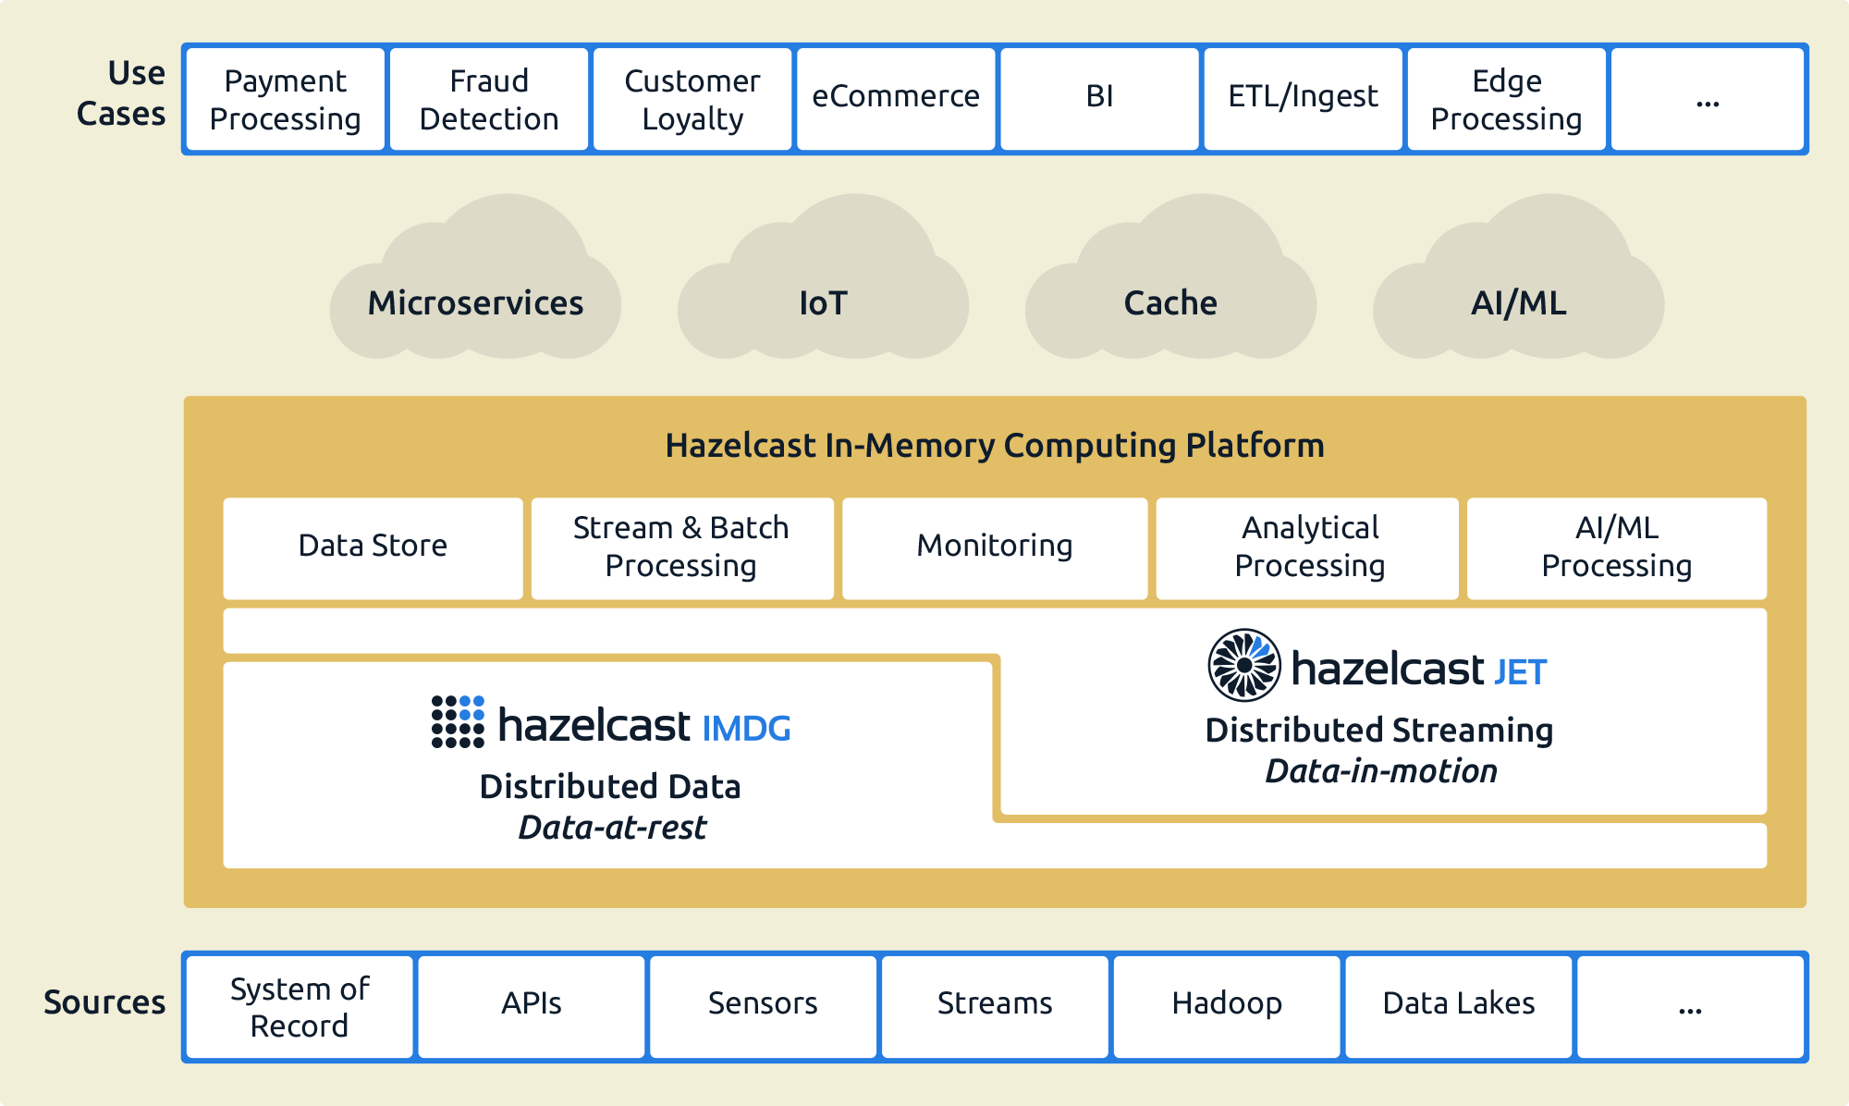
Hazelcast In-Memory Computing Platform
Notes:
Who has worked with hazelcast before?
Who know what Hazelast is?
Hazelcast, known as IMDG (NoSQL KV store, in-mem, distributed);
Hazelcast Jet -> stream processing

Slide 37
Jet Does Distributed Parallel Processing
Jet translates declarative code to a DAG
Pipeline p = Pipeline.create();
p.drawFrom(Sources.<Long, String>map(BOOK_LINES))
.flatMap(line -> traverseArray(line.getValue().split("\\W+")))
.filter(word -> !word.isEmpty())
.groupingKey(wholeItem())
.aggregate(counting())
.drainTo(Sinks.map(COUNTS));
Data Source
from
map
filter
aggr
to
Data
Sink
Notes:
Jet Does Distributed Parallel Processing
1/ Execution plan
2/ Execute it in parallel
How can be computation parallelized? Parallel primitives
How many instances of parallel instance to run?
How to route data between it - partitioning.

Slide 38
Jet Does Distributed Parallel Processing
Cluster member (2 cores)
read
map + filter
acc
cmb
sink
read
map + filter
acc
cmb
sink
Data
Sink
Data Source
Cluster member (2 cores)
read
map + filter
acc
cmb
sink
read
map + filter
acc
cmb
sink
Notes:
This is 2 machine, 2 cores each, partitioned source
1/ DAG in a distributed environment
DAG deployed to all cluster members
More cores
What can be parallelized?
Source - if partitioned, can read in parallel
Map/filter - can run in parallel
Extend the edges
Shuffing / moving data is expensive
Keeps data local, even reads it locally when co-located with the data source

Slide 39
Cooperative Execution
Cluster member (2 cores)
read
map + filter
acc
cmb
sink
read
map + filter
acc
cmb
sink
Data
Sink
Data Source
Cluster member (2 cores)
read
map + filter
acc
cmb
sink
Coop thread 1
read
map + filter
acc
cmb
sink
Coop thread 2
Notes:
2/ Coop multithreading, Green threads - to avoid context switch cost (thread switch)
- Context switch is non-productive time
Thread pool = CPU cores, Jet scheduler
Non-blocking code marked as cooperative
Coop processors assigned to cooperative threads
Switched by Jet with close to zero overhead
- No user intervention!
3/ Backpressure
All processors run together, connected by driven by data passing
- Acc is slow, upstreams cannot put more data to queue so they back off for a while, acc gets more CPU time
One monolithic stage won’t get you the efficiencies needed for what Jet does. More when taking about aggregations.
Use Pipeline API correctly and Jet makes it parallel.

Slide 40

All the Building Blocks
Pipeline: declarative, JDK
Source
Sink
Stream
Stream
Stream Processing Engine
Notes:
Animation
You create a pipeline
Pipeline defines sources and sinks and transform instructions
Submit pipeline to SPE
SPE creates a job from pipeline (decomposing it to small pieces running in parallel and distributed environment)
And starts processing data

Slide 41
Introducing the Jet Pipeline API

Slide 42
Pipeline API
Remember our building blocks?
API follows same pattern
Source
SPE (Transform)
Sink
Pipeline p = Pipeline.create();
//specify source(s) for stream p.drawFrom(Sources.<String>list("input"))
//specify transform operation(s) .map(String::toUpperCase)
//specify sink(s) for transform results .drainTo(Sinks.list("result"));
Notes:
Animations
Pipeline building blocks
Corresponding API has same building blocks
Fluent API - chain methods, use JavaDocs (don’t forget to instruct your IDE to download docs and sources too)
Adding method -> add another stage to the pipeline
We’ll cover in this lab
Create pipeline
Basic transforms
Sources / sinks
How to submit this pipeline to the cluster to make it a running job!

Slide 43
Sources and Sinks
drawFrom and drainTo require a source as a parameter
Libraries with sources and sinks available out-of-the-box
SourceBuilder and SinkBuilder classes for custom sources/sinks
p.drawFrom( Source definition )
com.hazelcast.jet.pipeline.Sources com.hazelcast.jet.pipeline.Sinks
Notes:
Animations
Pipeline starts with source
Pipeline ends with sink
That is the I/O definition

Slide 44
We’ll Start Simple
Turn off event-time processing for now
We’ll explain this when talking about windowing and event-time processing
p.drawFrom( Source definition ) .withoutTimestamps()
Notes:
Streams are time-series data
We don’t need it now - turn it off

Slide 45
Basic Transformation Operations
Filter: discards items that don’t match the predicate
Data cleaning, reformatting, etc.
Map: transforms each item to another item
Trim records to only required data
flatMap: transforms each item into 0 or more output items
Example: separate a line of text into individual words
Notes:
Animations
Filter – contracts data set (many to fewer)
Solicit examples from students
Map – one to one transformation
Solicit examples from students
FlatMap – expands data set (one to many)
Solicit examples from students

Slide 46
Transformation Examples
NewPowerCo has installed smart meters at all homes in a service area
Meters stream constant usage data: address, region code, kw/hour consumption, etc.
Filter example
Keep all records exceeding a given kw/hour rate
Map example
Strip addresses – keep only region code and kw/hour data
flatMap example
Separate record with multiple measurements to multiple records

Slide 47

Interacting with the Cluster
Embedded
Client/Server
We use embedded in the labs
Java API
Application
Java API
Java API
Application
Application
Java API
Java API
Java API
Java API
Application
Application
Application
Application
// Create new cluster member
JetInstance jet = Jet.newJetInstance();
// Connect to running cluster
JetInstance jet = Jet.newJetClient();
Notes:
Client, two ways how to get cluster handle
Use the handle to submit pipelines and control the lifecycle
1/ Starting new cluster member in app JVM
Start instance,
2/ Connecting to the running server
Somebody started the cluster, we just connect
Embedded in process - great for development.

Slide 48
Submitting the Pipeline
Use the cluster handle
Submit the job
Submit and return
Submit and block
Stop cluster when processing is done
public static void main (String[] args) {
JetInstance jet = Jet.newJetInstance();
Pipeline p = buildPipeline();
try { jet.newJob(p).join(); }
finally { jet.shutdown(); } }
jet.newJob(pipeline);
jet.newJob(pipeline).join();
Notes:
Use cluster handle to start the job
We’ll block and stop the cluster after the processing is done.

Slide 49

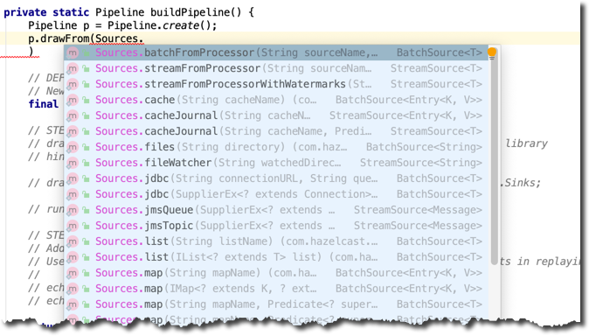
Lab 1: Filter Records from Stream
Step 1: log new lines
file watcher (infinite), it’s like tail -f
log sink
manually adding data to the directory to see the results
Step 2: Filter out “word” records
Notes:
Switch to your IDE
Implement the buildPipeline
Detailed instructions are embedded into lab skeleton.
Allow 25 minutes since this is the first one.

Slide 50
What We Learned…
The Pipeline
Basic connectors: fileWatcher, logging sink
Basic operators: filter, map, flatMap
Lambdas (serializable)
Embedded (in-process) JetInstance
Obtaining a cluster handle and submitting the job

Slide 51


Great for Moving Data to IMDG
Frequent solutions:
Custom data pumps
ETL tools with GUI
Jet brings:
Speed (works in parallel)
Fault Tolerance
Focus on business logic, not on infrastructure / integration
Java API
Kafka
Databases
Files
Hadoop
System of Record
ETL
Cache, Map, List
Notes:
WHY? Fault-tolerant, distributed runtime from ETL pumps
How to scale:
Transform -> not CPU intensive
Use distributed data soures
Run in the cluster > data load split between Jet nodes
Use distributed source - Kafka, HDFS, Hazelcast (Kinesis, S3)
Manualy distribute the files - each node has it’s part

Slide 52
Honorable Mentions
Connectors in Jet Library
Hazelcast, Journal, Kafka, HDFS, JMS, JDBC, Elasticsearch, MongoDB, InfluxDB, Redis, Socket, File
The list is growing fast!
Custom connectors
Builders: see the code samples
Examples: Twitter Source, REST JSON Service Source, Web Camera Source
Pipeline can have multiple sources, sinks and branches
Notes:
Animations
Highly-available “stream caching” - watch Kafka, updated cache for fast querying

Slide 53

Stretch/Bio Break
15 Minute Break
Notes:
Time upon return: 130 minutes.

Slide 54
Enrichment

Slide 55
Enriching the Stream
Do a lookup to enrich the stream
Similar to relations in RDBMS
dim_store
Id
Store_number
State_Province
Country
dim_date
Id
Date
Day
Day_of_week
Month
Month_name
Quarter
Quarter_name
Year
sales_fact
Date_id
Store_id
Product_id
Units_sold
dim_product
Id
EAN_code
Product_name
Brand
Product_category
Notes:
Use-cases: lookup tables to enrich stream, implementing star schema (https://en.wikipedia.org/wiki/Star_schema)
Main stream w/ facts
Dimensions in caches / databases

Slide 56
Enrichment Options
Local map
Advantage: fast, hard-coded
Disadvantage: change = redeploy
Remote service lookup (database, RPC call)
Advantge: always up to date
Disadvantage: slow retrieval
Cache local the custer
Hazelcast Jet contains rich distributed cache (thanks to embedded IMDG)
Distributed and elastic, scales with cluster size
Read/Write through for databases
Notes:
Multiple flavours of enrichment, trading-off performance for expressivenes
Hazelcast - in-mem NoSQL. In-mem = constantly fast access. Oftern used for caching. Distributed.
Start Jet, you get IMDG

Slide 57
Enrichment API in Jet
items.mapUsingIMap(
// the name of the lookup cache in Hazelcast
"enriching-map",
// how to obtain foreign key from the stream?
item -> item.getDetailId(),
// how to merge the stream with looked up data
(Item item, ItemDetail detail)
-> item.setDetail(detail)
)
Notes:
mapUsingImap on the Pipeline API
Uses distributed cache of Hazelcast
Again - declarative. You declare how, Jet orchestrates the calls.

Slide 58
Lab 2: Enrich the Stream
Table of company names
Streaming data:
Ticker code
Quantity Price
Enriched trade:
Company name Quantity Price
Enrich a trade stream using the cache
Randomly-generated “trade“ stream
Replace ticker code with company name
IMap (distributed map) caches name table
Notes:
Lab contains the trade generator - sources.Trade
20 min

Slide 59
Lab 2: Enrich the Stream
Enrich a trade stream using the cache
Use the Trade generator as a source
sources.TradeSource.tradeSource()
Trade contains the symbol - a foreign key, referring to a company
Lookup company name
Convert Trades to EnrichedTrades by enriching it with company name
IMap (distributed map) used for caching
Notes:
Animation adds note re: stopping lab 1. Explain why you need to do this.
Lab contains the trade generator - sources.Trade
Cache and Job - two standalone services in a cluster

Slide 60
What We Learned…
Trading off flexibility and performance
Enrich from local memory
Remote lookup
Enrichment from a cache
https://blog.hazelcast.com/ways-to-enrich-stream-with-jet/
Operators: hashJoin, mapUsingImap, mapWithContext
Jet Cluster provides powerful caching services
Notes:
How to scale
Cache distributed (not replicated), collocate stream with the cache partitions it needs -> data locality
Async lookup - increases latency but keeps throughput

Slide 61
Honorable Mentions
Hazelcast is a powerful distributed in-memory framework
Caching: read/write-through, JCache support
Messaging: buffer to connect multiple Jet jobs (journal)
Storage: in-mem NoSQL for low-latency use-cases (source, sink)
Coordination: unique
Polyglot (Java, Scala, C++, C#/.NET, Python, Node.js, Go)
These are IMDG clients – Jet pipelines are Java-only
Notes:
Demo OpenTTD
C++ client (possibly many of them)
Messaging
In-mem buffer, partitioned, partitioned / distributed for performance (each game instance uses it’s own partition)
In-mem K-V storage (distributed)
Event Listener
Stream processing

Slide 62
Aggregations and Stateful Streaming

Slide 63
Aggregations (Stateful Processing)
Combine multiple records to produce a single value
Examples: sum, average, min, max, count
Stateful processing
Concerns
Bounding the scope: batch, rolling and windowed aggregations
“Group by”: Global and keyed aggregations
Notes:
So far - stateless processors. Items processed one by one, independently.
Statefull - Aggregator carries the state between processing two items
Aggregation: typical stateful operation
Concerns
Bounding the scope
grouping

Slide 64
Bounding the Data
Scope - which data to aggregate?
”Since the app started” – potentially infinite with a stream!
“Last 30 seconds” defines a window
Frequency - When is the result provided?
With each item (frequent)
After all data in the scope were processed
In specified intervals - early results
Notes:
Continuous data
In the most general case, the state of stateful transformations is affected by all the records observed in the stream, and all the ingested records are involved in the computation. However, we’re mostly interested in something like "stats for last 30 seconds" instead of "stats since streaming app was started" (remember: the stream is generally infinite). This is where the concept of windowing enters the picture — it meaningfully bounds the scope of the aggregation.
When to provide the result. This is not the same as the input window. You could opt to
every time the result is updated,
all the data within the defined scope/window is processed,
Or at specific intervals.
Continuous programming model! Not there in batch systems.

Slide 65
Bounding the Data
Frequency Scope | Each input record | End of scope | Intermediate results*
Whole dataset | Rolling aggregation | N/A (Dataset generally infinite) | N/A
Window | Windowed aggregation with early results (*special case) | Windowed aggregation | Windowed aggregation with early results
Scope
*Frequency can be defined using time in Jet 3.0. More general behaviour might be used as well, e.g. data-driven.
Notes:
Rolling aggreg
Maximum temperature observed
Windowed agg
Slice the stream, give results when slice is completely processed
How much money we made in last hour? Sum of trades
Eary results
As before
Give us results so far

Slide 66
Aggregation API in Jet
Rolling aggregation
Windowed aggregation
Must include window definition (more on that after the lab)
Library with aggregate operations
count, sum, average, min, max, toList …
items.rollingAggregate(aggregateOperation)
items.window(def).aggregate(aggregateOperation)
com.hazelcast.jet.aggregate.AggregateOperations
Notes:
Aggregations declared in two steps
1 - Bound the data (scope, frequency)
2 - plug in the aggreg operation. Those are reusable!
Rolling aggregate - show in table

Slide 67
Lab 3: Rolling Aggregation
Compute maximum trade price observed
Scope: whole dataset
Output frequency: with each input item
-> Rolling aggregation
Make sure you stopped Lab 2!
Notes:
Only 15 minutes

Slide 68
Types of Windows
Tumbling
(size)
1
2
3
Sliding
(size + step)
1
2
3
Session
(timeout)
1
2
Notes:
Animation
Scope = slices
How to slice infinite stream?
Usually defined by time as streaming data are timestamped events.
Tumbling windows: windows in series, no overlap, same size. “result for time 0-1”, “result for time 1-2”, etc.
Sliding windows: windows in series, same size, but stepping by offset and overlapping
Typical step value is 1% of window size
HZ outputs every time window slides. Ex: 1 second window gives 10 millisecond step. So results are 0:00-1:00, 0:10-1:10, etc.
Tumbling x Sliding
- Tumbling Aggregate data from 10 to 11, then from 11 to 12
- Sliding: aggregate data from last hour, the hour slides with time, step = granularity
3) Session: based on inactivity timeout. Window opens when activity starts, closes when activity ceases + set idle timeout value
In a session window, the items are grouped into variable size, * non-overlapping windows which are formed by periods of activity followed * by inactivity. A session window is kept open as long as the gap * between the events remains less than the given {@code sessionTimeout} and * is closed when the gap exceeds the timeout.

Slide 69
Windowing API in Jet
Declare the aggregation as windowed
items.window(windowDef).aggregate(aggregateOperation)
com.hazelcast.jet.pipeline.WindowDefinition
session, sliding, or tumbling
com.hazelcast.jet.aggregate.AggregateOperations
count, sum, average, min, max, toList …
Notes:
Bound the window with the aggregation
Continuous stream on the input
Window slices the stream to windows and runs the aggregation on it, emits results
Type

Slide 70
Timestamps
Timestamp in record metadata (e.g. Kafka)
From embedded in record
Need to specify how to extract the timestamp
Jet uses local clock to timestamp the record
.withNativeTimestamps()
.withTimestamps(r -> r.getTimestamp())
.withIngestionTimestamps()
Notes:
Timestamps
TS to be used to assign data to window
withTimestamp - lambda to extract it from data
Intestion - current wall clock time
Native - timestamped stream (source gave us the timestamps)
- different sources produce different data

Slide 71
Event Time Processing
Events
(timestamps)
11 | 14 | 12 | 33 | 22 | 41 | 35 | 2 | 46
Frames
10 - 19
20 - 29
30 - 39
40 - 49
30 second window
No ordering
How long will we wait for stragglers?
Notes:
At t=250

Slide 72
Lab 4: Windowing
Compute sum of trades for 3-second intervals
Tumbling window
Output each 3 seconds, should be roughly constant
Compute sum of trades for 3-second intervals, result so far each second
Tumbling windows with early results
Output each second, grows for 3 seconds and then drops
(Optional) Compute sum of trades in last 3 seconds, update each second
Sliding windows
Output each second, should be roughly constant
Notes:
3 steps,
20 minute

Slide 73
Grouping
Global aggregation
One aggregator sees the whole dataset
Complex Event Processing use-cases (if A is observed after B then do C)
Keyed aggregation
GROUP BY from the SQL
Splits the stream to sub-streams using the key extracted from each record
Sub-streams processed in parallel
Grouping API in Jet
users.groupingKey(User::getId)

Slide 74
Grouping
Global aggregation
One aggregator sees the whole dataset
Complex Event Processing use-cases
if A is observed after B then do C
Keyed aggregation (SQL GROUP BY)
AAPL
averageLong(Trade::getPrice)
Trades
GOOGL
averageLong(Trade::getPrice)
MSFT
averageLong(Trade::getPrice)
Notes:
Typically you don’t want to aggregate all the items together, but classify them by some key and then aggregate over each group separately.

Slide 75
Grouping API
users.groupingKey(User::getID)
Groups event objects by specified key
Groups processed in parallel
Notes:
To create groups, use the grouping API to specify which field in the event should be used as the key for creating the groups.
Jet will create as many groups as needed as it learns the different field entries. All objects with the same key will be placed in the same group.
Jet processes each group in parallel for optimum performance.

Slide 76
Lab 5: Grouping
Compute sum of trades for 3-second intervals per ticker
Per-ticker results for the previous lab
Notes:
Hint: KWR as a result.
10 minutes

Slide 77
Aggregations - Takeaways
Aggregations combine multiple input records to a single value
Aggregate the whole stream or split it using a key and aggregate the sub-streams (GROUP BY)
Define the scope of the aggregation: whole dataset or a window
How often does aggregate operation provide the result?
With each record
When the scope has been processed
Something in between
In specified intervals (early results)
Data-driven (Not supported by Jet now)
Notes:
Scope -> how to select items to be aggregated from the continuous stream?
Result frequency -> when send results downstream

Slide 78
Honorable Mentions
Cascade aggregate operations
Aggregate aggregations (e.g. maximal average value)
Flight Telemetry Demo
Use grouping for join and correlation
Windowing to be added for streaming join
https://docs.hazelcast.org/docs/jet/latest-dev/manual/#cogroup
Custom aggregation API
Notes:
T = 330

Slide 79

Lunch Break
60 Minute Break

Slide 80
Scaling and Operations

Slide 81
Scaling and Fault Tolerance
Jet clusters can grow and shrink elastically
Add members to accommodate workload spikes
Workload is dynamically distributed across all cluster members
Resilience through redundancy
Fault tolerance (network, server)
Cluster redistributes workload to available members
Notes:
Add more processors, more CPUs more memory
Uses same mechanism for up and down scales
TODO limits of scaling (grouping keys < global parallelism)

Slide 82
How Jet Fault Tolerance Works
Regular backups (snapshots)
Restart computation from last snapshot if topology changes
Single node failures/additions - snapshot restored from replicated memory storage
Preconditions:
Replayable source (e.g Kafka, Hazelcast Event Journal, not JMS)
Deterministic (no mutable lookup tables, no randomness)
Idempotent sink
Notes:
How it works
- Idea: stream is replayed from the snapshotted state
Rewind source to an offset, restore state, replay
If source isn’t rewindable
Caveats:

Slide 83
Jet Application Deployment Options
Embedded
Client/Server
We switch to client-server now!
Java API
Application
Java API
Java API
Application
Application
Java API
Java API
Java API
Java API
Application
Application
Application
Application
No separate process to manage
Prototyping, Microservices. OEM.
Java API for management
Simplest for Ops – nothing extra
Separate Jet cluster
Isolate Jet from the application lifecycle
Jet CLI for management
Managed by Ops
Notes:
We switch to client-server now!
Start and control the cluster, deploy applications

Slide 84
Command Line Tools
/bin/
Command line tooling for Jet
jet-start.sh, jet-stop.sh
Control cluster lifecycle
jet.sh
Control job lifecycle
Command-line alternative to the Java API
Notes:
This is in Jet downloadable
Download it,
Tools to control jet cluster

Slide 85
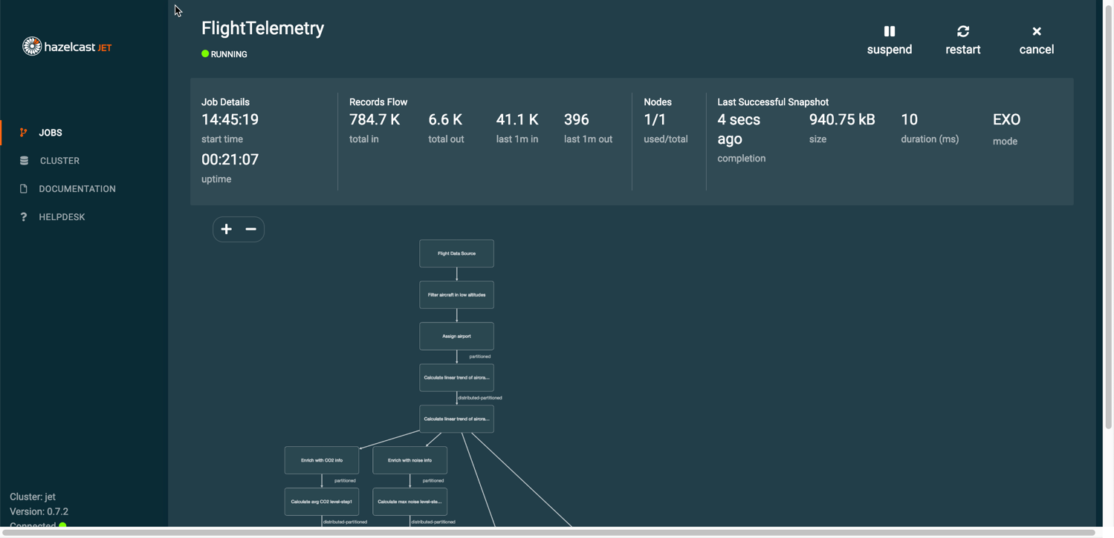
Jet Management Center
Notes:
Web console
Job management
Resource utilization
Dataflow inspection tool

Slide 86
Ops demo
https://github.com/vladoschreiner/hazelcast-jet-job-upgrade/tree/instructions
Notes:
License - trial sentd via e-mail

Slide 87
Rolling Job Upgrades
Allow jobs to be upgraded without data loss or interruption
Processing Steps
Jet stops the current Job execution
It then takes the state snapshot of the current Job and saves it
The new classes/jars are distributed to the Jet nodes
The job then restarts
Data is read from the saved snapshots
All of this in a few milliseconds!
Management Center
CLI
Java API
Version A
Continue (A/B) or finish (upgrade)
Snapshot
Version B

Slide 88
Lossless Recovery: Before Lights Out
Hot Restart Store
Jobs, Job State, Job Configuration configured to be persistent with Hazelcast’s Hot Restart Store capability
Checkpoints are similarly configured to be Hot Restartable
Jet is configured to resume on restart
Hot Restart Store
Hot Restart Store

Slide 89
Lossless Recovery: Automatic Job Resumption
When cluster is restarted, Jet discovers it was shut down with running jobs
Jet restarts the jobs
Checkpoints are recovered
For streaming, rewindable sources are rewound using saved offsets (Kafka, Hazelcast IMap, Hazelcast ICache events).
If the source cannot be fully rewound, the job is terminated with error, or continued, depending on configuration
Batch sources are resumed from last pointer, otherwise from the beginning
Hot Restart Store
Hot Restart Store
Hot Restart Store
Source Stream
Rewinding
0 1 2 3
Checkpoints
After Restart, resume from checkpoint 3:
3 4 5 6
Notes:
After restart, only the hot restart stores remain. The cluster discovers it was shut down with running jobs.

Slide 90
Security Suite: Job Submission
Jet Clients
TLS / SSL
Authentication
Authorization
TLS/SSL
OpenSSL
Hazelcast Jet Client
JAAS Authentication
JAAS
Authorization
Hazelcast Jet Client
Mutual
Authentication
Socket Interceptor
Socket Interceptor
Hazelcast Jet Client
Symmetric Encryption
TLS / SSL
Browser
Mutual
Authentication
Mutual
Authentication
TLS / SSL
Authentications
Authentication
Authorization
LDAP /
Active Directory Authentication
JAAS Authentication
Read/Write
Read only
Metrics only
Management Center

Slide 91
Security Suite: Data Pipeline
Hazelcast Jet Cluster
Source System (such as Kafka, Oracle, MySQL, Active MQ)
TLS / SSL
TLS / SSL
Sink System
Hazelcast Jet job running in a cluster
Source Connector
Sink Connector
Authorization
Authorization
Mutual
Authentication
Mutual
Authentication
Authentication
Authentication
Internally: TLS / SSL, Symmetric Encryption

Slide 92
Scaling and Operations - Takeaways
Jet can run embedded (in-process) or in a Client-Server mode
Elastic clustering for scaling and increasing resilience
Preconditions: replayable source, deterministic computations without side effects, idempotent sink
Tools for monitoring and managing the cluster and the jobs
Command line tools in /bin
Management Center

Slide 93
Honorable Mentions
Other deployment options
Docker
Kubernetes
Hazelcast Cloud
Job Upgrades
Lossless Recovery
Security

Slide 94
Q and A
Next Up … IMDG

Slide 95
Hazelcast IMDG
Version 3.12 May, 2019
(Instructor name here – I tried to make this auto-fill)

Slide 96
Course Objectives

Slide 97
Lab Setup
Requirements
Java 8 JDK
An IDE like IntelliJ IDEA*, Eclipse, Netbeans
A build system like Maven, Gradle, sbt
Steps
Download the lab source
https://github.com/hazelcast/training
Import into your IDE
*Used in examples
Notes:
Start here to allow students time to download and set up everything while you do the rest of the introductions

Slide 98
Topologies

Slide 99
Review: Two Main Topologies
Embedded
Client/Server
IMDG
IMDG
Java API
Application
IMDG
IMDG
IMDG
IMDG
Java API
Java API
Application
Application
Java API
Go API
Application
Application
Rapid Prototyping
Microservices Architectures
OEM integration
Python API
Application
Scale-Up and Scale-Out Deployments
Decouple scaling of Storage and Application
Ease GarbageCollection Optimization

Slide 100

Embedded Pros and Cons
Easy to get started
Easy deployment
In a cluster of size x, 1/x of the data is local to the reader
Service and storage is on JVM
Harder to optimize garbage collection
Harder to scale
Hard to minimize data movement
Can’t just “restart the app”

Slide 101
Client/Server Pros and Cons
Most commonly used
Easily scalable
Additional security options (Enterprise)
Segregates storage and application (GC optimization)
Operational separation between client application and server cluster
Separate setup of standalone cluster
No data locality

Slide 102
Discovery

Slide 103
What is Discovery?
Form
Find
Join
?
Hazelcast IMDG Cluster
?
Hazelcast Instance
?
?
?
Hazelcast Instance
?
?
Hazelcast Instance
?
?
Notes:
Discovery is the mechanism used by cluster members to build and maintain the cluster.
When you start up a cluster, the first cluster member starts looking for other cluster members.
When a second member starts up, it also begins looking for other cluster members.
When the two members find each other via discovery, they form the cluster.
Now, when new members start up, they find the cluster,
And join the existing cluster.

Slide 104
Hazelcast Discovery Options
TCP/IP - multicast and unicast
Discovery plug-ins for cloud
Discovery Service Provider Interface (SPI)

Slide 105
TCP/IP Multicast
I’m at 10.2.3.4
Send and listen on configured multicast address and port (224.x.x.x:yyy)
Members learn and build direct TCP connections
Useful for test/POC environments
Not suitable for production
Hazelcast Instance
I’m at 10.2.3.4
TCP
I’m at 10.2.3.8
I’m at 10.2.3.8
Hazelcast Instance
I’m at 10.2.3.4
I’m at 10.2.3.8

Slide 106
TCP/IP Unicast Discovery
New members connect to specified list of IP addresses
First two form the cluster
Later members learn complete list when connecting
Best practice #1: Specify at least two peer addresses in config
Best practice #2: Specify local IP interface used for cluster access

Slide 107
TCP/IP Unicast Discovery Configuration
<hazelcast> ... <network> ... <join> <multicast enabled="false"> </multicast> <tcp-ip enabled="true"> <member>machine1</member> <member>machine2:5799</member> <member>192.168.1.0-7</member> <member>192.168.1.21</member>
<interface>192.168.1.10</interface> </tcp-ip> ... </join> ... </network> ... </hazelcast>
Specify cluster members
Host name or address
Range of addresses
Port number optional
Specify local interface address

Slide 108

Discovery Plug-Ins
Hazelcast-Supported | Community-Supported
Apache jclouds AWS Azure Eureka Google Cloud Platform (GCP) Kubernetes OpenShift Pivotal Cloud Foundry (PCF) Zookeeper | Consul .etcd Heroku

Slide 109
Discovery Service Provider Interface (SPI)
Develop your own discovery plug-in
Fully documented in IMDG Reference Manual
Example using lookup in /etc/hosts on Github under Hazelcast Code Samples

Slide 110
Partitioning
Notes:
I pulled this entire section from the online training because the classroom training had some significant flow issues.

Slide 111
What is a Partition?
A “chunk” of memory that holds data
P1
P2
P3
P4
...
Pnnn
Your Data
Partition number = (hash of key/name) MOD (partition count)
Notes:
A partition is simply a segment of a data structure stored in memory.
When you start up a Hazelcast cluster member, the stored data is divided into partitions.
The actual number of partitions depends on which version of Hazelcast you’re running - in three dot one one, we use
two hundred and seventy one partitions. The actual size of each partition depends on the amount of memory available to your cluster member.
The data in your data structure is then stored in one of the partitions.
Specifically, for those who like these details, Hazelcast hashes the object key or object name, then mods it with the number of partitions to generate the number of the partition where the particular object will be stored. That’s nice to know, but in most cases won’t matter much when you’re working on your code.

Slide 112

Partitioning Across a Cluster
Primary
Backup
I’m the oldest member - I’ll keep you all updated.
Member1
Member2
P1
Partition | Primary | Backup
P1 | 1 | 2
P2 | 2 | 1
Pn | 1 | 2
P1
Partition | Primary | Backup
P1 | 1 | 2
P2 | 2 | 1
Pn | 1 | 2
P2
P2
P3
P3
P4
P4
.
.
.
.
.
.
P271
P271
Notes:
Why partitions are important is that they provide data redundancy - one of two reasons you implement Hazelcast in a cluster. (The other is increased performance, which we cover in another course.) Each cluster member is the primary owner of some partitions, and the backup owner of others. Your data read-writes will be done from the primary partition, and Hazelcast will replicate the data automatically to the backup.
Each member of the cluster also keeps a partition table that lists which cluster member is primary and backup for each partition.
In order to keep all the members in sync, the oldest member of the cluster periodically sends the table contents to all other cluster members. The default interval for these updates is 15 seconds, but you can adjust that if needed.

Slide 113
Adding a Member (Data Rebalancing)
Primary
Backup
Here’s the latest partition table!
Member1
Member2
Member3
P1
P1
Partition | Primary | Backup
P1 | 1 | 3
P2 | 2 | 1
Pn | 2 | 3
P1
Partition | Primary | Backup
P1 | 1 | 3
P2 | 2 | 1
Pn | 2 | 3
P1
Partition | Primary | Backup
P1 | 1 | 3
P2 | 2 | 1
Pn | 2 | 3
P1
P2
P2
P1
P2
P3
P3
P3
P1
P3
P3
P4
P4
P4
P4
P1
.
.
.
.
.
.
.
.
.
P271
P271
P271
P271
P271
Notes:
When you add a member to the cluster,
Hazelcast automatically rebalances the distribution of partitions so that each member has an equal number of primary and backup partitions. Hazelcast uses a rebalancing algorithm that moves the fewest number of partitions possible while ensuring an equal load across all cluster members.
The oldest member creates an updated table, then sends it to all the cluster members.

Slide 114
Removing a Member
Primary
Backup
I’m the oldest cluster member now!
Member1
Member2
Member3
P1
P1
P1
1
Partition | Primary | Backup
P1 | 3 | 2
P2 | 2 | 3
Pn | 2 | 3
P1
Partition | Primary | Backup
P1 | 3 | 2
P2 | 2 | 3
Pn | 2 | 3
X
X
X
X
X
X
P2
P2
P2
P3
P3
P3
P3
P4
P4
P4
P4
P4
.
.
.
.
.
.
.
.
.
P271
P271
P271
P271
Notes:
If a member leaves the cluster,
whether through failure or because it was shut down,
The members that held the backup copy of the affected partitions become the primary for those partitions.
Hazelcast then rebalances the backup distribution so that the load is again shared equally by all members.
If the failed member was the oldest member, the next oldest member in the cluster takes over the table distribution duties.

Slide 115
Why Does This Matter to a Developer?
Synchronous vs. Asynchronous Backups
Partitioned vs. Non-Partitioned Data Structures
Notes:
If you’re sitting there thinking, “I’m an app developer - why do I care about the details of how my data is shifted around in memory?”... well, here’s two things you need to understand as you’re working on your code.
You need to understand the difference between a synchronous backup and an asynchronous backup,
And you need to understand which Hazelcast data structures can be partitioned… and which ones can’t.

Slide 116

Synchronous Backups
put
Primary
Backup
block until 2 acks
1001101
1001101
ack
ack
Hazelcast Cluster
Assures backup is complete and available if needed
Blocking operation - can lead to latency issues
Notes:
A synchronous backup ensures that both the primary and the backup partition have the same data.
When an application executes a put instruction,
The Hazelcast cluster returns a message telling the application to wait for acknowledgement. The number of acknowledgements depends on the number of partitions where the data must be written. In this case, we need two acknowledgements - one for the primary and one for the backup.
The cluster writes the data to the member holding the primary partition and sends an ack.
Then the cluster writes to the member holding the backup partition and sends another ack. Once the application has both acks, the block is removed and the application can continue.
The advantage to a synchronous backup is that it makes sure that your data writes are being backed up as they occur, so if there’s a failure in the cluster, your data is still available.
The disadvantage is that the ack process introduces some latency into your data processing while your application waits for acknowledgements.

Slide 117
Asynchronous Backups
Primary
Backup
put
1001101
1001101
done!
Hazelcast Cluster
“Fire and forget”
Relies on Hazelcast internal synchronization to complete backup
No blocking, but less assurance of backup availability
Notes:
With asynchronous backup, you avoid the blocking problem. Once the data is in the primary partition, the application can continue processing.
The Hazelcast cluster will write the data to the backup partition at some later point in time.
This operation is sometimes called “fire and forget” - once the data is in the primary partition
We rely on Hazelcast’s internal operations to ensure that the data is copied to the backup partition and is kept in sync with the primary partition
Asynchronous backup gets rid of the blocking problem, but relies on the stability of the Hazelcast cluster itself to ensure the availability of consistent backup partitions in the event of a failure.

Slide 118
Configuration
<hazelcast> <map name="default"> <backup-count>1</backup-count> <async-backup-count>1</async-backup-count> </map> </hazelcast>
Can have both sync and async for same map
6 total backups shared by sync and async
Make sure you have enough distributed memory!
Default setting: backup count of 1, no async backup
Notes:
You can specify the number and type of backups you want.
For synchronous backups, use the backup-count setting. You can have up to six backups of each partition. The more synchronous backups you set, the longer it takes for Hazelcast to write all the backup partitions and return an ack to your application. You could also set the backup count to zero, which means that particular data structure will have no backups. This provides you with the equivalent of asynchronous backup performance, but no redundancy at all.
For asynchronous backups, you can also specify up to six backups for each partition.
You can have both synchronous and asynchronous backups for the same data structure.
But no more than six total backups for the data structure
Just make sure that, whatever you specify, you have enough distributed memory for the primary and all the backup data.
If you do not specify otherwise, Hazelcast defaults to a synchronous backup count of 1, with no asynchronous backup.

Slide 119
Data Safety
How many backups do you really need?
One backup is most common
Consider memory consumption
Consider overall resource availability if a node fails
If multiple nodes are failing regularly, backups won’t solve the problem

Slide 120
You Can’t Partition Everything!
Partitioned | Non-Partitioned
Map MultiMap Cache (Hazelcast JCache implementation) PN Counter Event Journal | Queue Set List Ringbuffer Lock ISemaphore IAtomicLong IAtomicReference FlakeIdGenerator ICountdownLatch Cardinality Estimator
Notes:
Not all Hazelcast data structures can be partitioned. When you are writing code, you need to understand how the data structure you use will affect memory utilization across the cluster.
The screen shows which Hazelcast data structures can be partitioned and which ones cannot. For now, you just need to understand the general difference between the two types.

Slide 121
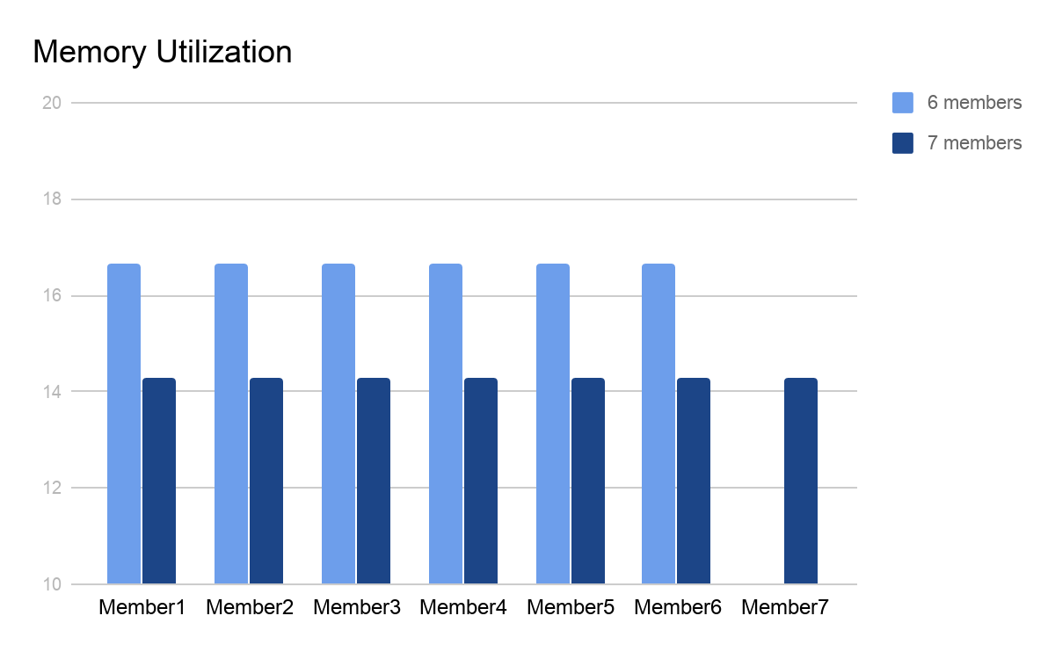

Memory Utilization - Partitioned
Member1
Member2
Member3
Member4
Member5
Member6
Member7
Notes:
You can think of a partitioned data structure like a cake. Just as a cake can be sliced into equal sized pieces
A partitioned data structure is divided equally across the number of available members.
If you add another device to the Hazelcast cluster, the partitions are redistributed so each virtual machine has an equal amount of cake.
A memory utilization graph shows this even distribution. For simplicity’s sake, the graph only shows the primary partitions. If you are using backups, the utilization would double, but would still be evenly distributed.

Slide 122

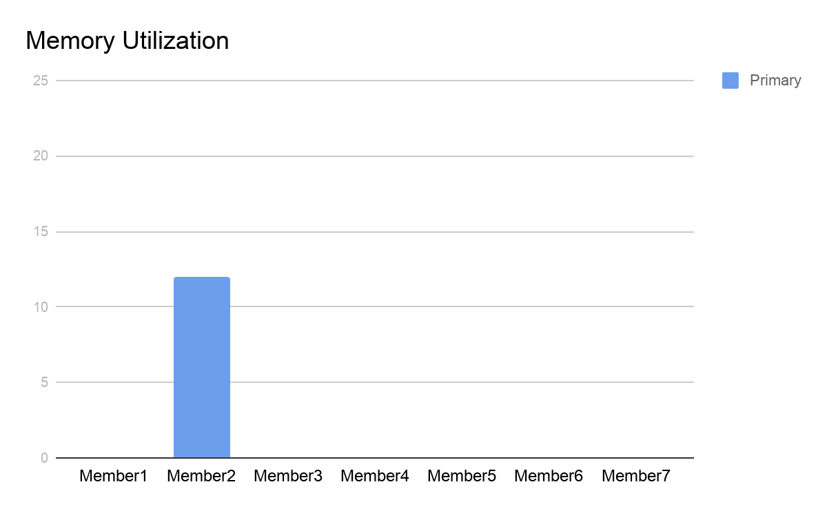
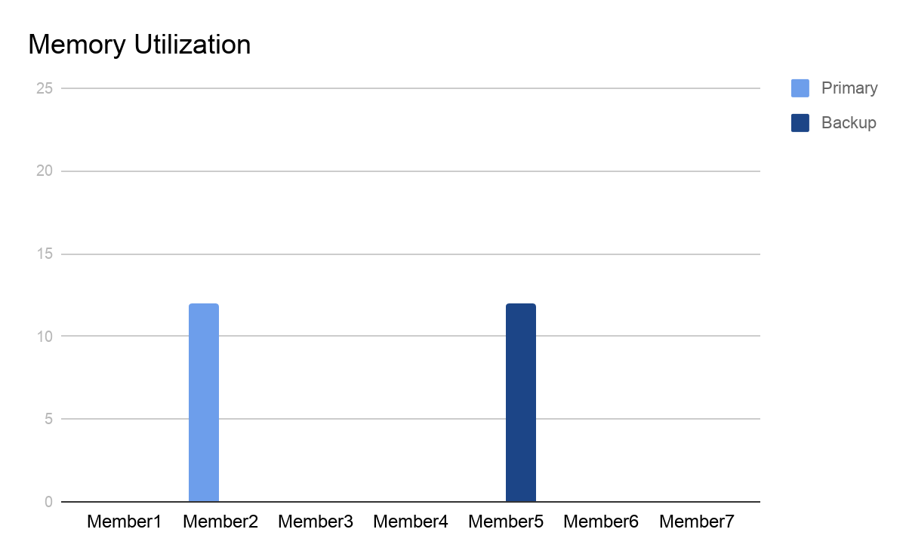
Memory Utilization - Non-Partitioned
Member1
Member2
Member3
Member4
Member5
Member6
Member7
Notes:
A non-partitioned data structure is like a kitten. The kitten can only go into one member - it won’t be distributed across multiple virtual machines. The actual partition used for the data structure is determined by the MOD function we discussed earlier in the presentation.
A memory utilization graph for this data structure will show that only member2 is storing this data. Again, this graph only shows the primary data structure.
A graph that shows both primary and backup would show identical utilization on two members - one for the primary and one for the backup.

Slide 123
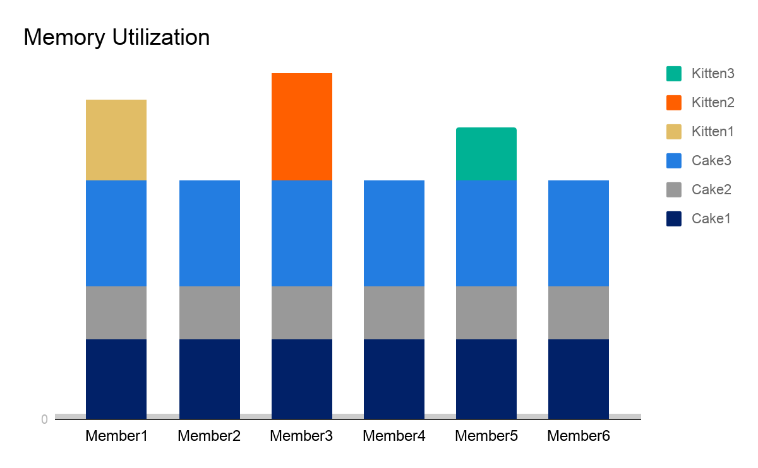





Memory Balancing
Member1
Member2
Member3
Member4
Member5
Member6
Notes:
In a real application, you’ll have many data structures all sharing the same pool of memory across your members.
Hazelcast will distribute the partitioned data structures evenly across all members,
And distribute the non-partitioned structures based on the MOD value for the data structure.
Utilization will balance out as much as possible, but you won’t see a completely equal distribution if you have non-partitioned data structures in your application.
The graph only illustrates distribution of primary partitions, not backups.

Slide 124
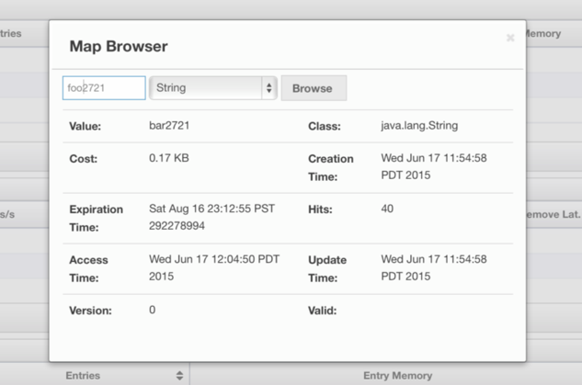
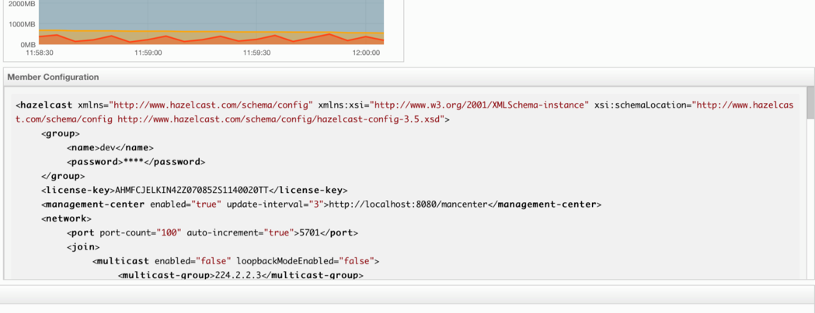
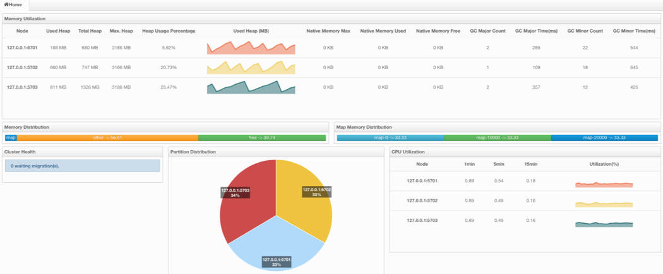
Management Center
Analyze & Browse Data Structures
Cluster & Data Configuration
Cluster Statistics

Slide 125
Lab 6: Partitioning
Start Hazelcast server
Start Management Center
Push data to cluster through client
Observe operations via Management Center
Estimated time: 15 minutes
Notes:
T = 40

Slide 126
Stretch/Bio Break
15 Minute Break
Notes:
Time upon return: 130 minutes.

Slide 127
IMap: Expiration and Eviction

Slide 128


Expiration and Eviction
Purpose: to use memory efficiently and to prevent memory overruns
Expiration removes unused entries after a configured amount of time
Eviction removes entries when memory use reaches a configured limit
Notes:
Both expiration and eviction are used by an IMDG cluster to make memory utilization more efficient and to prevent your application from running out of memory.
Expiration removes map entries based on time limits. You configure how long an entry can remain in the map before it’s considered to be “too old” and is removed.
Eviction is only used if your application reaches a configured memory use threshhold. You can use eviction without expiration, expiration without eviction, or use both features together.

Slide 129
How Expiration Works
You configure the starting values
Two types of timer
Activity resets when entry is read
Both reset when entry is updated
Key:Value Pair | Activity | TTL
550
480
3550
1:Alpha
600
3480
600
3600
1:Omega
3600
2:Beta
530
3530
600
600
3600
3490
560
3560
3:Gamma
600
3600
Entry is removed from map if timer reaches 0
You can configure just one or both types of timer
Notes:
Expiration uses two timers - an activity timer and a time to live timer.
You set the starting values for these timers in your configuration.
When an entry gets added to the table,
The entry timers are set to the values you configured, and the countdown begins
Each entry has its own timers.
As entries are added, the timers continue to count down.
If an entry is read, the activity timer is reset, but the time to live timer keeps counting down.
If an entry is updated, both timers are reset.
If either the activity or the time to live reaches zero, the entry is removed from the map.
You can configure just an activity timer, just a time to live, or both types of expiration.

Slide 130
Configuring Expiration Policies
Configured on per-map basis
Default is set to 0 (no expiration)
<map name=”myMap">
<time-to-live-seconds>300</time-to-live-seconds>
<max-idle-seconds>1800</max-idle-seconds>
</map>

Slide 131
Setting Timers for Specific Entries
Set timers when adding data to table
ttl and ttlUnit parameters
myMap.put( "1", "John", 50, TimeUnit.SECONDS, 40, TimeUnit.SECONDS )
key
value
maxIdle and maxIdleUnit parameters
Modify TTL for existing entry
myMap.setTTL( "1", 50, TimeUnit.SECONDS )
Notes:
When you configure an expiration policy, it’s applied to all entries in the map. You can override this behavior for specific map entries in a couple of different ways.
You can set the timers on an entry when you put it in the table.
Add the time to live and ttl unit, and the max idle and max idle unit parameters to the put code as shown. If you just want to set the activity timer, you need to set the time to live to zero.
You can also modify the time to live for an existing table entry with setTTL. Specify the key, the time to live, and the time to live units.

Slide 132
Eviction
Max-size policy - many options!
IF (memory use = configured threshold) {
remove entries based on configured policy;
}
LFU: Least frequently used
LRU: Least recently used
Custom
Notes:
Eviction is best understood as an if-then statement.
Eviction only takes effect if your memory utilization reaches a configured maximum. Once that maximum is reached, the cluster will evict map entries based on the configured policy until memory utilization drops below the maximum.
You have two built-in options for the removal policy - least frequently used removes the entries that have been used least. Least recently used removes the entries that have been idle the longest. You can also create custom removal policies if these two options aren’t suitable for your needs - consult the IMDG Reference guide for details.
When it comes to max size policy, you have several options to choose from. We’ll look at those options next.

Slide 133
Max Size Policy Options
Total number of entries - limit individual map size
PER_NODE | Maximum number of map entries per cluster member
PER_PARTITION | Maximum number of map entries per partition
Memory in use (cannot use in-memory format of OBJECT)
USED_HEAP_SIZE | Maximum amount of used memory in megabytes for each JVM
USED_HEAP_PERCENTAGE | Maximum percentage of used memory for each JVM
Memory available
FREE_HEAP_SIZE | Minimum amount of free memory in megabytes for each JVM
FREE_HEAP_PERCENTAGE | Minimum percentage of free memory for each JVM
Notes:
Your first choice for setting a maximum size is to set a limit based on number of map entries. You can set a maximum number of map entries per cluster member, or a max number of entries per partition. Because these limits are based on entry counts, these policies are best used to limit the size of individual maps rather than for overall memory management.
The second choice is to set your policy based on amount of memory in use. This is calculated based on the total memory available to the Java Virtual Machine hosting the cluster member. Note that you cannot use the in-memory format of object for maps if you want to use this eviction policy; the cluster cannot determine the memory footprint for data in object format.
The third choice is to set a minimum acceptable amount of free memory. Again, this is calculated based on the total memory available to the JVM.

Slide 134
Enterprise Max Size Policy Options
Requires in-memory format to be set to NATIVE
USED_NATIVE_MEMORY_SIZE | Maximum used native memory size in megabytes for each Hazelcast instance
USED_NATIVE_MEMORY_PERCENTAGE | Maximum used native memory percentage for each Hazelcast instance
FREE_NATIVE_MEMORY_SIZE | Minimum free native memory size in megabytes for each Hazelcast instance
FREE_NATIVE_MEMORY_PERCENTAGE | Minimum free native memory percentage for each Hazelcast instance
Notes:
If you are using Hazelcast IMDG Enterprise HD, you have additional options based on memory size. These options require your in-memory format to be set to native. The first two evict based on the amount of memory in use by maps.. The second evicts based on the amount of free memory available in the JVM.

Slide 135


Limiting Map Size Using PER_NODE
How big do you want your map to get?
max_size = total map size / members
I want to limit my map to 10000 entries. I have 5 cluster members.
max_size = 10000 / 5
max_size = 2000
<max-size policy=”PER NODE”>2000</max-size>
<eviction-policy>LFU</eviction-policy>
put
Cluster member
= 2000
Notes:
If you’re using a PER_NODE policy, your objective is to limit the size of a particular map.
However, you have to remember that your map is equally distributed across multiple cluster members, so the max_size is not the size of the overall map, but the number of entries a particular cluster member will hold. Just divide your overall maximum map limit by the number of cluster members to get the max_size setting.
So if I want to limit my map to a total of ten thousand entries, and I have five cluster members,
I’ll divide ten thousand by five to get a max_size setting of two thousand entries per cluster member.
I add this to my configuration, then set the eviction policy to remove the least frequently used entry.
If my app tries to write to a partition on a cluster member that already has 2000 entries in that map
The cluster will remove the least frequently used entry from the partition that needs to receive the new data. Keep in mind that, in a real-world implementation, entries are almost-evenly distributed amongst partitions - the partition assignment depends on the hash of the entry key. Likewise, partitions are almost-evenly distributed amongst members. This can result in evictions happening before reaching 10,000 total entries, but you are guaranteed never to exceed 10,000.

Slide 136
Limiting Map Size Using PER_PARTITION
max_size = total map size / number of partitions
I want to limit my map to 10000 entries. I have 200 partitions.
max_size = 10000 / 200
max_size = 50
Not a good option for smaller clusters
put
Cluster member
50
48
49
47
50
Notes:
If you use PER_PARTITION, the max_size calculation changes. Now it’s the total map size divided by the number of partitions
So if I want to use per partition with the same total map size, and I have 200 partitions in my cluster,
My max_size is 50 entries per partition.
Per_partition is not a good option for smaller clusters. The smaller the cluster, the more partitions each member has to maintain.
You can wind up degrading performance because the cluster member has to do so many eviction evaluations. With a larger cluster, the puts are more widely distributed and therefore the evaluations and possible evictions.

Slide 137
Controlling Map Size by Memory Use
I want to make sure no one map uses up all the available memory
<max-size policy=”USED_HEAP_SIZE”>100</max-size>
<eviction-policy>LFU</eviction-policy>
Used memory is per map, not per cluster member
Consider number of cluster members, total map size, and other maps/memory use
Total map size: 500 MB
Cluster members: 5 Cluster members: 2 Cluster members: 1
USED_HEAP_SIZE: 100 MB USED_HEAP_SIZE: 250 MB USED_HEAP_SIZE: 500 MB
Notes:
Instead of using entry counters, you can control map size based on the amount of memory a given map consumes.
The used heap and used native memory options limit the size of a map to either a configured number of megabytes, or a configured percentage of overall memory available on the cluster member.
Because this calculation is based on how much memory the specific map consumes,
You need to consider several factors when setting this value or percentage. How many cluster members will share the map? How big is the overall map? Will the limit you set reserve enough memory for other maps or other uses?
For example, if you want to limit the map size to 500 megabytes, the used heap size you configure will vary depending on the number of cluster members. Will this limit ensure that there’s enough memory for other operations? If not, you may need to add more memory to your cluster members, add cluster members, or reduce your used heap size limit and accept that more evictions may occur.

Slide 138
Controlling Memory Utilization
I want to evict entries if unused memory is less than 5% of total memory.
<max-size policy=”FREE_HEAP_PERCENTAGE”>5</max-size>
<eviction-policy>LFU</eviction-policy>
Free memory options are good for wildcard or default policy
Individual map size is not a consideration
If “something else” consumes memory, maps get evicted
Notes:
If you’re not worried about the size of an individual map and just want to make sure that maps in general do not consume all available memory, you can use the free heap and free native memory options.
The free memory options are good for use in wildcard or default map configurations
as they do not consider individual map size or consumption - only the total amount of memory available on the cluster member.
The trade off is that if anything brings memory use to the configured threshold - whether it’s a map or another type of data structure or in-memory processing - maps will be evicted.

Slide 139
Manual Eviction
map.evictAll()
Removes all unlocked entries from map
Any eviction method will not remove locked entries
Notes:
You can manually remove all entries from a map using evict all
This will remove all unlocked entries from the map
In fact, any of the eviction methods we’ve discussed will not affect locked map entries. We’ll discuss locking in another lesson in this course.
Just to demonstrate, we’ll run a bit of code. We’re creating a map of 1000 entries, and locking 4 of them. We’ll then use evict all to remove everything from the map except the locked entries. When we run this code, we can see that

Slide 140
Lab 7: Eviction
Configure eviction with 5 elements per member
Push data to cluster
Estimated time: 15 minutes
Notes:
T = 70

Slide 141
High-Density Memory Store

Slide 142
High-Density Memory Store (HDMS)
Enterprise feature
Alternative in-memory storage implementation
Data stored outside of garbage-collected heap
Managed by IMDG itself
Maximizes usable memory per machine
Scales into hundreds of gigabytes.
JCache (Icache)
Map (IMap)
APIs
On-Heap Memory Store (Objects Stored as Objects)
2-4GB (Limited by Garbage Collection)
Memory Stores
Member
Client (Near Cache)
High-Density Memory Store (Objects Serialized and Stored as Bytes)
0-1TB (Limited by Machine RAM)
RAM in JVM Process

Slide 143
Optimizing Garbage Collection
Minimizes heap size handled by garbage collector
Delivers more predictable latency
 | On-Heap | HDMS
Native Storage | 0 MB | 3.3 GB
Heap Storage | 3.9 GB | 0.6 GB
Major GC | 9 (4900 ms) | 0 (0 ms)
Minor GC | 31 (4200 ms) | 356 (349 ms)

Slide 144
Configuring HDMS
Set up HDMS and define size
Note: memory assigned to HDMS is not part of heap or available to rest of JVM
Define data structure(s) that will use HDMS
<hazelcast>
<native-memory enabled="true"> <size value="1" unit="GIGABYTES"/> </native-memory>
</hazelcast>
<hazelcast>
<map name="training"> <in-memory-format>NATIVE</in-memory-format> </map> </hazelcast>

Slide 145
Sidebar: In Memory Format Setting
Default is BINARY
Both key and value stored in serialized binary format
Best if most map operations are gets and puts
NATIVE is same as binary but uses HDMS
OBJECT stores value in non-serialized format
Key is still binary
Best if map operations are mostly queries and and entry processing
Removes deserialization cost

Slide 146
IMap: Persistent Data (External Connectivity)

Slide 147
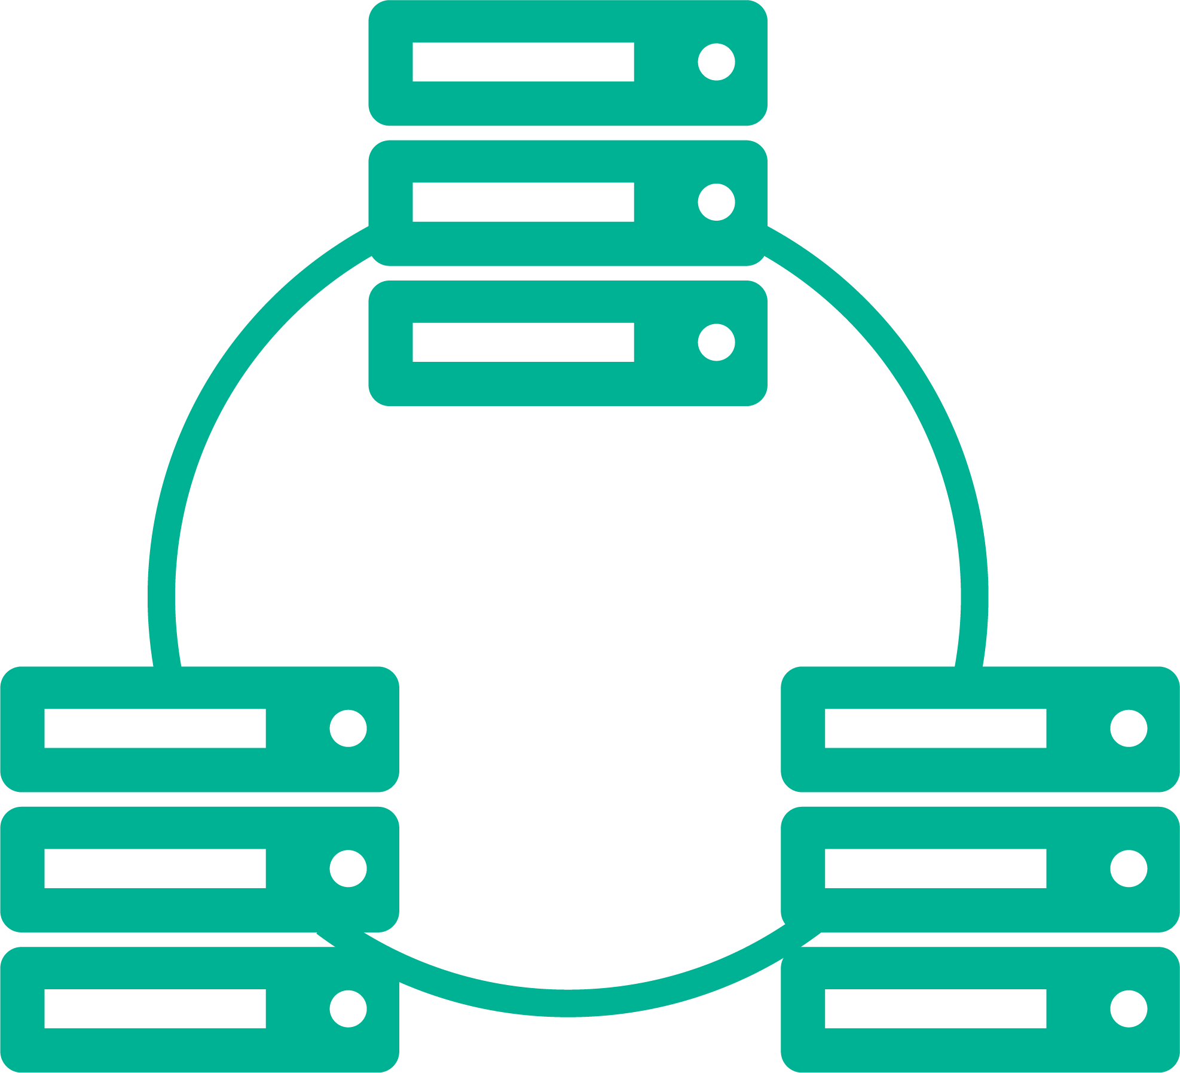

Persistent Data Overview
get
put
MapLoader
MapStore
get 1
load 1
Read-through persistence
Notes:
One of the most common applications of Hazelcast IMDG is as an in-memory cache for a persistent data store - in other words, as a fast front-end processor for a relational database.
Your application interacts with the cluster to provide fast in-memory access and computation,
And the cluster interacts with the data store to retrieve the initial data for caching and to write back to the data store when things change.
The majority of your interactions continue to be with the IMap, using gets and puts.
Hazelcast uses MapLoader and MapStore to interact with the data store.
If your application tries to get an entry that doesn’t exist in the map, and the map has MapLoader configured,
The cluster member will retrieve the entry from the data store
And add it to the local map, then return the requested value to the application.
This is called read-through persistence and is enabled automatically when you create a MapLoader configuration for a map.

Slide 148
Look Aside Caching
2
Read DB (if not in cache)
3
Write to Cache
1
get 1
Notes:
Probably the easiest. Made almost transparent by Spring @Cacheable
Step 2 and 3 Only Happen if there is miss
Use expiration to manage life time of objects in cache
There is no way to know if all objects are in cache (usually not) so queries don’t work as expected

Slide 149
Write-Through Persistence
1
put 1, value
3
2
store 1, value
Synchronous updates to data store
Notes:
When it comes to writing data back to the data store, you have two options for configuring your MapStore. The first is write-through persistence.
When you use write-through, you are performing synchronous updates to the data store.
When you put a value to the map,
The cluster first calls MapStore to pass the value through to the data store.
It then writes the update to the primary map, then to the backups.

Slide 150
Write-Behind Persistence
1
put 1, value
2
3
store 1, value
Asynchronous updates to data store
Allows batch operations
Notes:
With write-behind persistence,
Your updates to the data store are asynchronous.
Your put to the map is
Written to the primary map and backup map immediately.
The entry is marked as dirty, meaning it hasn’t been written to the data store yet.
After a configured interval, the cluster writes all marked data to the data store. If you configure an interval of 5 seconds, every 5 seconds the cluster will store all marked data. In other words, the longest delay between writing to memory and writing to the store will be 5 seconds, but it could be less depending on when the put occured in the 5 second interval.
If the write is successful, the dirty marker is removed.
A key reason to use write-behind persistence is to allow batch operations such as bulk stores and bulk deletes. Write-through persistence does not support batch operations.

Slide 151
Implementation
Create class for MapLoader/MapStore
MapStore is subinterface of MapLoader
Class contains details for each type of transaction
load
loadAll
delete
deleteAll
store
storeAll
loadAllKeys
Class contains location of data store
Reference class in map configuration
Notes:
To implement a maploader or map store,
Create a class for it. You can look at examples of map store classes in the document attached to this lesson. The link is below the player window.
MapStore is a subinterface of MapLoader. Don’t be confused that the class only implements MapStore - all MapLoader functionality is also included.
The class contains the details for each type of transaction. The example code shows the basic actions.
The class also contains the location of the data store that this implementation will access.
To use this class, reference it in the configuration for the map that will be used in conjunction with the data store.

Slide 152
MapLoader
public class MyExternalConnectivity implements MapLoader<K, V> {
public V load(K key) {
return …;
}
When call is made for IMap.get(K)
If entry exists, it is returned; loader code is not called
If entry does not exist, loader code is called
If code returns null, caller gets null
If code returns non-null, entry is added to IMap and returned to caller

Slide 153
Pre-Loading
getMap() triggers MapLoader.loadAllKeys
loadAllKeys returns Iterable that can be populated by queries
Member is selected as “key-loader” and retrieves all keys
Member distributes keys in batches to all other members
Members retrieve values using MapLoader.LoadAll(Keys)
Initial Load Mode = LAZY, getMap call returns when partition is loaded
Initial Lode Mode = EAGER, getMap call returns when entire map is loaded
Notes:
Your map is initialized when you first call a getMap. The getMap triggers the load all keys operation from your map loader or map store class.
Note that if your data set is large, it is more efficient to load your keys incrementally rather than loading them all at once. To support incremental loading, the MapLoader.loadAllKeys() method returns an Iterable which can be lazily populated with the results of a database query.
One member of the cluster is selected to be the key loader, and retrieves all keys from the persistent data store.
That member then distributes the keys to the other members. Each member gets the keys for the data stored in their local partitions.
Each member then calls the load all function using the key set it received.
If Initial Load Mode is set to LAZY in the configuration, the get map call will return as soon as the partition containing the matching key is fully loaded.
If Initial Load Mode is set to EAGER, the get map call won’t return until the entire map is loaded into all partitions.

Slide 154
MapStore
When IMap contents change, MapStore code is called to update the external store
public class MyExternalConnectivity implements MapStore<K, V> {
public void store(K key, V value) {
…;
}
public void delete(K key) {
…;
}
//bulk methods
public void storeAll(Map<K, V> map) {
…;
}
public void deleteAll(Collection<K> keys) {
…;
}

Slide 155
Evict, Delete, Remove
Method | Erase in-memory | Erase from store | Return value
map.evict
Y
N
N
map.delete
Y
Y
N
map.remove
Y
Y
Y
Use the right method for your desired outcome
Notes:
A quick side note on removing data from memory and from the data store
Evict is strictly a local operation. It removes the entry from the in memory map, but does not affect the underlying data store.
Delete, on the other hand, will remove the entry from both the map and the data store.
Remove also deletes the entry from both the map and the data store, but returns the deleted value to the application.
Make sure you’re using the correct method for your desired outcome.

Slide 156
Configuration
<map name="dataStoreMap"> …
<map-store enabled="true" initial-mode="LAZY">
<class-name>com.hazelcast.examples.DummyStore</class-name>
<write-delay-seconds>60</write-delay-seconds>
<write-batch-size>1000</write-batch-size>
<write-coalescing>true</write-coalescing>
</map-store>
</map>
Notes:
So now let’s look at the configuration.
As we said on the previous slide, the map store configuration is part of the overall map configuration. The name here must match the name of the map you reference when you define the map in your code.
…
Map store is enabled, and we’re using the default initialization mode of lazy. More on initialization in a couple of slides.
Next we reference the class we created that has our loader and store setup.
Write delay determines whether we are using write-through or write-behind persistence. If we set the delay to 0, we’ll use write-through. If we set the delay to any other value, we’ll use write-behind persistence and delay our attempt to write to the data store for the configured number of seconds.
If we’re using write-behind, we can write our data in batches. The default is to send all the queued writes at once, but you can configure a maximum batch size so as not to overwhelm the data store.
In write-behind mode, keys with multiple writes are coalesced and only the last written value is copied to the data store. You can set this to false to write all values.
</map>

Slide 157
Synchronization - Writing
Can you accommodate temporary deviation?
Use write-behind persistence
Changes in IMap happen at memory speed
Can’t accommodate temporary deviation?
Use write-through persistence
Changes in IMap wait on external store

Slide 158
Synchronization - Reading
What if data changes in external source?
IMap will continue to use out-of-date local data
Periodically expire IMap data
MapLoader will refresh entry when needed
Change data capture
Use http://www.striim.com/ to push changes from supported external stores into Hazelcast
Write your own version
Notes:
End of Day 1
T = 105

Slide 159
IMap: Queries

Slide 160
Hazelcast Distributed Query
FIND data that matches a given criteria
FILTER remotely to return only matching data to application
IMDG Cluster
Hazelcast Instance
Hazelcast Instance
Hazelcast Instance
FIND/FILTER performed in parallel
Faster return - no unnecessary data, no wasted bandwidth
Query: retrieve all entries for employees under age 40
Notes:
The purpose of a query is to extract information from a map data structure.
Put simply, you want to find the data in the map that matches a given set of criteria
And you want only that data returned to your application.
The key to Hazelcast’s distributed query is that it performs the filtering function within the cluster. Instead of returning the entire map to the application and then filtering locally, the cluster only returns the data that matches the query. This has two advantages:
Because the cluster consists of multiple members, each with their own CPUs, the find and filter operation is performed in parallel. Each cluster member searches its own local portion of the distributed map.
The only data that’s returned to the application is the requested data, so you’re not wasting bandwidth or CPU cycles waiting for data that isn’t needed.

Slide 161




How Queries are Executed
IMDG Cluster
Hazelcast Instance
Hazelcast Instance
Hazelcast Instance
Query: retrieve all entries for employees under age 40
Notes:
An application initiates a query by sending it to one of the cluster members. It doesn’t matter which member; the connection is likely already established. The cluster member that receives the request does two things.
It begins searching the queried map on all local partitions
And it sends query execution requests to all other cluster members.
These members perform the search on their local partitions
And return all matching entries to the cluster member handling the query.
The query handler combines the returned results with its own local results
And returns them to the application.

Slide 162
Predicates
interface Predicate<K, V> extends Serializable {
boolean apply(Map.Entry<K, V> mapEntry);
}
IMDG Cluster
Hazelcast Instance
Hazelcast Instance
Hazelcast Instance
Used to construct the “search string”
Only entries that match will be returned to the application
Uses “apply method”: if predicate = true, return entry
Query: retrieve all entries for employees under age 40
Notes:
Predicate is the interface that is used to construct your queries.
A predicate specifies the criteria for the query - you can think of it as the “search string” or the “match criteria” for the query.
The query will return map entries that match the passed predicate.
To get technical, the query execution uses the apply method as shown in the interface code - if the predicate is true for a given entry, then add that entry to the data to be returned in response to the query. We will revisit the predicate interface itself later in this lesson.

Slide 163
Predicates Two Ways...
Criteria API
Data Set: Employee
Objects:
name (String)
age (int)
salary (double)
active (boolean)
IMap<String, Employee> map = hazelcastInstance.getMap( "employee" );
EntryObject e = new PredicateBuilder().getEntryObject();
Predicate ActiveUnder30 = e.is( "active" ).and( e.get( "age" ).lessThan( 30 ) );
Collection<Employee> employees = map.values( ActiveUnder30 );
SQL Query
Query: return entries for active employees under the age of 30
IMap<String, Employee> map = hazelcastInstance.getMap( "employee" );
Collection<Employee> employees = map.values( new SqlPredicate( "active AND age < 30" ) );
Notes:
Hazelcast offers two methods for writing queries. We’ll look at examples of both of them.
We’re working with a data set called Employee that contains objects for name, age, salary, and status. Values associated with these objects are stored in our map. You can look at the code that created this class by opening the downloadable document associated with this lesson. The link is located below the playback window.
We want to return the map entries for active employees that are under the age of 30.
One method to write this query is to use the Criteria API. In this code sample, we retrieve the map, create an entry object called e that references the predicate builder, create the predicate with the match criteria - active and age under 30, then use the collection method to return the values that match the predicate.
The same query in SQL retrieves the map, then creates a data set populated by entries that match the sql predicate active and age less than 30. If you didn’t follow either of those… no worries. We’re going to look more closely at both methods on the next few screens.

Slide 164
Using the Criteria API
Similar to Java Persistence Query Language
Includes common operators
Comparison: equal, notEqual, greaterThan, greaterEqual, lessThan, lessEqual
Pattern matching: LIKE 'Alic%', ILIKE (case-insensitive), REGEX (for standard regular expressions)
Member test: name IN ('Bob', 'Alice')
Range: age BETWEEN 20 and 33
Complete list of operators in Hazelcast Javadocs
Notes:
The Criteria API is
Similar to the Java Persistence Query Language.
The API includes many operators you can use to create your predicates
Including the usual comparison operators
Pattern matching operators LIKE, which matches a string with variables, ILIKE, which is a case-insensitive version of like, and regex for matching regular expressions
Member test evaluators to return whether the listed values are in the collection,
And a range option that will return entries that match the given range. This evaluation is inclusive - the example will return entries with ages 20 and 33 as well as all values in between.
You can find a complete list of operators in the Hazelcast Javadocs.

Slide 165
Using AND, OR, and NOT
Use to combine predicates
Example: return all entries with a salary greater than $50,000 and are under age 35
IMap<String, Employee> employeeMap = hazelcastInstance.getMap("employee");
Predicate salaryPredicate = Predicates.greaterThan("salary", 50000);
Predicate agePredicate = Predicates.lessThan("age", 35);
Predicate salaryAndAge = Predicates.and(salaryPredicate, agePredicate);
Collection<Employee> result = employeeMap.values(salaryAndAge);
Notes:
You can use and, or, and not to combine predicates.
In this example, we want to search for all entries with a salary greater than 50 thousand dollars and are under age 35.
First, we retrieve the map that contains the employee data.
Next, we create a predicate to match the salary value
Then create a second predicate to match the age range
We combine them with the and operator to create a predicate called salaryandage.
We then use the predicate to create the collection Result. This predicate will now search the Employee class and return the values of all objects that match the combined predicate criteria.
You replace AND with OR or NOT in the same way. Or returns entries that match one of the listed predicates, and NOT returns records that do not match the listed predicates.

Slide 166
Using the PredicateBuilder class
Same query: return all entries with a salary greater than $50,000 and are under age 35
IMap<String, Employee> employeeMap = hazelcastInstance.getMap("employee");
EntryObject entry = new PredicateBuilder().getEntryObject();
Predicate salaryAndAge =(entry.get("salary").greaterThan(50000)).and(entry.get("age").lessThan(35));
Collection<Employee> result = employeeMap.values(salaryAndAge);
Notes:
Another option for creating predicates is to use the PredicateBuilder class. We’ll use it here to create the same query as in the previous example.
We start the collection the same way. (two clicks)
Next, we create an EntryObject called entry that uses the predicatebuilder class.
We can then create our predicate using a single line of code.
And return the results.

Slide 167
Using Distributed SQL Query
Allows you to write queries in SQL format
Operators
Comparison: =, !=, >, >=, <, <=
Pattern matching: name LIKE 'Alic%', ILIKE (case-insensitive), REGEX (for standard regular expressions)
Member test: name IN ('Bob', 'Alice')
Range test: age BETWEEN 20 AND 33
AND, OR, and NOT
Notes:
You can also use SQL predicte to write queries in SQL format.
The available operators are the same as with Criteria API,
Comparison operators
Pattern matching
Member test
And range test
You can also use and, or, and not to combine criteria. The difference between Criteria API and SQL Query is strictly one of syntax - use whichever one is easiest for you.

Slide 168
Distributed SQL Query Example
Same query: return all entries with a salary greater than $50,000 and are under age 35
IMap<String, Employee> employeeMap = hazelcastInstance.getMap( "employee" );
Collection<Employee> SalaryAndAge = employeeMap.values( new SqlPredicate( "salary > 50000 AND age < 35" ) );
Behind the scenes: SqlPredicate converts SQL format into predicate tree (as in Criteria API)
Can use both types of queries interchangeably
Notes:
Let’s use SQL to create the same query.
Once again, we’ll begin by creating the map that will contain the data returned by the query.
Instead of using collection, we’ll create a set from the Employee class called Salary and Age, add the set to the employee map, then specify the predicate.
What’s actually happening when you run this query is the SQL Predicate class is converting the SQL format into the same predicate format we just learned in the Criteria API.
This means that you can use both formats interchangeably.

Slide 169
IMap with JSON
IMap supports JSON objects
Query as you would any other object
String person1 = "{ \"name\": \"John\", \"age\": 35 }";
String person2 = "{ \"name\": \"Jane\", \"age\": 24 }";
String person3 = "{ \"name\": \"Trey\", \"age\": 17 }";
IMap<Integer, HazelcastJsonValue> idPersonMap = instance.getMap("jsonValues");
idPersonMap.put(1, new HazelcastJsonValue(person1));
idPersonMap.put(2, new HazelcastJsonValue(person2));
idPersonMap.put(3, new HazelcastJsonValue(person3));
Collection<HazelcastJsonValue> peopleUnder21 = idPersonMap.values(Predicates.lessThan("age", 21));

Slide 170
JSON to Java “Translation”
Hazelcast IMDG treats JSON values as Java types for comparison to query
JSON Primitive | Java Primitive
number | long if possible double if not
string | String
true | boolean
false | boolean
null | null

Slide 171
JSON Metadata
Hazelcast stores a metadata object per HazelcastJsonValue
Speeds querying throughput
Increases put latency
Stored on-heap even if data itself is in NATIVE off-heap memory
Disable if put performance is more important than throughput
<map name="map-a">
<!--
valid values for metadata-policy are:
- OFF
- CREATE_ON_UPDATE (default)
-->
<metadata-policy>OFF</metadata-policy>
</map>
MapConfig mapConfig = new MapConfig();
mapConfig.setMetadataPolicy(MetadataPolicy.OFF);

Slide 172
Custom Predicates
If standard predicates do not meet your needs, use PREDICATE interface
Example: return entries with name length = 10
class NameLengthPredicate implements Predicate<int, Employee> {
@Override
public boolean apply(Map.Entry<int, Employee> entry) {
Employee person = entry.getValue();
return person.getName().length() == 10;
}
}
Pros:
Flexible
Possibly more performant than SQL-like queries for full scans
Cons:
Lots of boilerplate code
Does not support indexing
Notes:
Because predicate is a defined interface, you can use it to create custom predicates if the standard ones do not meet your needs.
We’ll create a predicate that returns entries where the length of the name is 10.
We create a class that implements the predicate interface.
Add the override
Then create our boolean function. Remember, all the predicate does is evaluate whether an entry matches. If the predicate returns true, the entry is added to the collected data. If it returns false, the entry is not.
We get the value from the employee data,
And return entries where the name length is 10.
Custom predicates are very flexible, and may perform better than SQL queries under most conditions.
However, they do include a lot of boilerplate code, as shown above. And most importantly, custom predicates do not support indexing. We’ll talk more about indexing later in this lesson.

Slide 173
Paging Predicate
Allows retrieval of data page by page
Specify predicate
Specify page length
IMap<String, Employee> employeeMap = hazelcastInstance.getMap( "employee" );
EntryObject entry = new PredicateBuilder().getEntryObject();
Predicate salaryAndAge = ( entry.get( "salary" ).greaterThan( 50000 ) ).and( entry.get ("age").lessThan( 35 ) );
PagingPredicate PageLength10 = new PagingPredicate( salaryAndAge, 10);
Collection<Employee> getWithSalaryandAge = employeeMap.values( PageLength10 );
//do something with the entries ... this is omitted here
PageLength10.nextPage();
getWithSalaryandAge = employeeMap.values( PageLength10 );
Notes:
Paging predicate is a special class of predicate that
Allows you to retrieve data one page at a time.
You specify both the predicate that is used to filter the data
And the page length.
Let’s return to the same example we’ve been using and add a page predicate to retrieve 10 entries at a time.
We begin the same way - get the map
Set up predicate builder
And create the predicate.
Now we create the paging predicate, giving it the name pagelength10, referencing the salary and age predicate we created on the previous line, and setting the page length to 10.
The collection line now retrieves the first 10 entries that match the predicate.
We do something with the entries… whatever your application requires
To set up the next page, we reference the paging predicate we created and add nextpage,
Then retrieve the next 10 entries.

Slide 174
Paging Predicate and Comparators
Entries forming a sequence may be ordered using a Comparator
Comparator<Map.Entry> ageOrderComparator = new Comparator<Map.Entry>() {
public int compare(Employee e1, Employee e2) {
Employee Em1 = (Employee) e1.getValue();
Employee Em2 = (Employee) e2.getValue();
return e2.getAge() - e1.getAge();
}
PagingPredicate PageLength10 = new PagingPredicate( salaryAndAge, ageOrderComparator, 10);
If no explicit comparator is used, entries will be ordered naturally
Entries must implement java.lang.Comparable
Notes:
If you have entries that form a sequence, you can order them using a Comparator, a standard Java interface.
In our code sample, we’ve created a comparator that compares all the employee age entries and places them in descending order.
We then reference the comparator in the paging predicate, between the query predicate and the page length.
If you don’t use a comparator, entries will be placed in a natural order. If you’re retrieving values, the data will be ordered based on values. If you’re retrieving keys, the order will be based on keys. If you’re retrieving complete entries, ordering will be based on values if the values are comparable; otherwise keys will be used.
What we mean by comparable is that the data being used for ordering myst implement java.lang.Comparable. If the data does not implement this, you will get an Illegal Argument exception.

Slide 175
Inner Predicates in Paging Predicates
Return all entries with age = 33, 20 entries at a time
Predicate age33Predictate = Predicates.equal( "age", 33 );
PagingPredicate Length20 = new PagingPredicate( age33Predicate, 20);
PagingPredicate Length20 = new PagingPredicate( new SqlPredicate("age=33"), 20);
Notes:
If your query predicate is simple, you can opt to include it directly into the paging predicate definition rather than creating a separate predicate.
If we wanted to return all employee entries where the age equals 33, for example,
We could define a predicate that returns all entries with age equal to 33, then place the query predicate within the paging predicate,
Or we can define the predicate directly inside the paging predicate. Both sets of code return the same results.

Slide 176
Paging Predicate Caveats
Each node might send a full page of results to the caller
the caller wants a full page of results
each node doesn’t know how many results the others will send so it has to set a full page just in case
the caller discards the excess
For 10 nodes and a page size of 5, you might get 10 * 5 = 50 results
For 100 nodes and a page size of 50, you might get 100 * 50 = 5,000 results
Potential to overflow the caller’s memory
Not usually a problem, but just be aware

Slide 177
Lab 9: Queries
Create cluster
Store entries with value being UserModel
Create query to find users between age 18 and 21
Run query
Estimated time: 15 minutes
Notes:
T = 30 minutes

Slide 178
End of Day 1

Slide 179
Q and A
Next Up … IMDG

Slide 180
Indexing

Slide 181
Indexes
Speed up queries by avoiding full scans
Without indexing, objects have to be de-serialized
Two types
Ordered - for order comparison queries (range queries)
Unordered – for equality queries (point queries)
new SqlPredicate("age > 33")
new SqlPredicate("age > 33 and age <= 66")
new SqlPredicate("age between 33 and 66")
new SqlPredicate("name = 'Bob'")
new SqlPredicate("name in ('Alice', 'Bob')")
Notes:
Indexes speed up query execution by avoiding full-scans when possible. When a query runs on a member, Hazelcast will iterate through all the owned entries and find the matching ones. This can be made faster by indexing the mostly queried fields, just like you would do for your database. Indexing will add overhead for each write operation but queries will be a lot faster. If you query your map a lot, make sure to add indexes for the most frequently queried fields.
There are two types of indexing
Ordered indexing is best when your queries search for ranges of values. The ordering makes processing these queries much faster, offsetting the overhead of the initial ordering processing and increased memory consumption.
Unordered indexing is best when your queries are searching for particular entries where ordering entries gives you no advantage.

Slide 182
Using Indexing
Recommendation to use with primitive types for best speed
byte, short, int, long, float, double, String
Only use ordered indexing with orderable values (numbers)
Downside: index needs reordering when data is updated
Unordered indexing does not prevent full scan
Performance gain comes from no de-serialization

Slide 183
Composite Indexing
Use when frequent query is an AND
Unordered composite index
All predicate values are point queries
new SqlPredicate("name = 'Bob' and age = 33")
Ordered composite index
Multiple point queries plus one ordered predicate
new SqlPredicate("name = 'Bob' and salary > 50000")
Notes:
A composite index can speed queries that combine predicates.
If your frequent query is a combination of two or more predicates, you can create a composite index for the queried fields.
You should use an unordered composite index
When all the predicates in the query are point queries.
In this example, the query is always looking for a specific name and a specific age. Although the example shows only two predicates, you can combine as many predicates as you need for your search. As long as all the queries are equality queries, you can use the unordered composite index.
An ordered composite index
Can include multiple equality predicates plus a single ordered predicate.
In this example, we have a point query for name combined with a salary range. Again, you can use more than two predicates, but all should be point queries except one.

Slide 184
How Composite Indexing Works
aardvark
abacus
abbey
abbreviation
abdomen
ability
.
.
.
azimuth
azrael
azure
babe
baboon
babushka
.
.
.
Point query = “prefix”
Searches that are fully answered by index
new SqlPredicate("letter1 = a")
new SqlPredicate("letter1 > a")
new SqlPredicate("letter1 = a and letter2 <= m")
new SqlPredicate("letter1 = a and letter2 =z and letter3 > a")
Searches that are partially answered by index
new SqlPredicate("letter1 = a and letter 2 > b and letter 3 = a")
new SqlPredicate("letter1 = a and letter 2 > b and letter 3 > a")
Notes:
You can think of your composite index
like a list of words in a dictionary. The first letter of a dictionary is perfectly sorted. The second letter is also sorted, but only in reference to the first.
We can quickly find all entries that begin with the letter A,
but it is slower to find all entries that have the letter A as the second letter because we have to read all the first letters to get to the second one.
However, it’s very quick to find all entries that have A as the first letter and z as the second letter because we’re using that first perfect indexed value as part of our point query.
It helps to think of the point query part of your search as a fixed prefix that prefilters your ranged query before the comparision query gets applied.
Using our dictionary example, the following queries can be fully answered by a composite index. In the first two examples, we’re only looking at the first indexed value. In the third example, the prefix is A, so the index can limit the comparison to only those entries beginning with A - the index makes finding that subset of entries very fast. In the last example, the prefix is AZ, again limiting the comparison to only those entries beginning with AZ.
Other combined predicates can still be sped up somewhat by composite indexing, but will have to run through two iterations of comparison to return the result. In the first example, the prefix is A, but we have to perform a comparison to return all entries where the first letter is a and the second letter is greater than B. We can then pass those results outside of the index through the third match to extract all words that begin with A, have a second letter greater than B, and a third letter equal to A. Likewise with the second example - Letter 1 is the prefix, letter 2 is the comparison. Those results can then be run outside the index against the letter 3 comparison.

Slide 185
Setting Up Indexing
Set up in configuration
STRONGLY recommend using declarative
<map name="employeeMap">
<indexes>
<index ordered="false">name</index>
<index ordered="true">age</index>
<index ordered="false">name,age</index>
<index ordered="true">name,salary</index> </indexes>
</map>
Notes:
Indexing is part of the configuration of a map.
Hazelcast strongly recommends using declarative configuration for indexing. If you use programmatic configuration, you may lose your indexing if the cluster restarts, which will have a negative impact on the performance of your queries. Placing the configuration in the XML file ensures that it’s read when the cluster members start.
To set up an index, you either set ordering to true or false, then specify the field that will be used for the index. If you’re using composite indexing, specify all the fields for the index.

Slide 186
Indexing Cautions
Unordered indexes are very slow at performing range queries
Each index consumes memory
Custom predicates need to implement com.hazelcast.query.IndexAwarePredicate
Bad selectivity = bad performance
Example - boolean attribute isActive
Alice
isActive
"name = 'Alice' and isActive"
Notes:
Some things to be aware of when using indexing
Unordered indexes are very slow when performing range queries. Make sure you use the right index type for the data and the types of searches you’ll be doing.
Indexing consumes additional memory. You need to make sure that the performance benefit offsets the memory cost, particularly in the case of composite indexes.
If you’re using custom predicates, you specifically have to implement the index aware predicate interface.
And finally, indexing will not help you if the indexing doesn’t really reduce the amount of data you have to search.
For example, let’s look at the boolean attribute isActive from our Employee data.
Most employees are active,
so when you do an indexed query - in this example, looking for all records that match the name Alice and are active,
The isActive part of the query returns all the active entries. In this case, you’re adding overhead by creating an index that doesn’t give you any performance gains, so you’re better off not indexing this particular attribute.

Slide 187
Serialization
Notes:
At Day 2, t=40

Slide 188

Serialization
Object
Binary
Serialization
10010 01010
11001
Deserialization
Objects can’t be sent via network
Most Hazelcast operations are remote, so serialization is all over the place and often happens multiple times
The faster the serialization algorithm, the faster is Hazelcast IMDG!

Slide 189
Serialization Examples
IMap put
IMap set
IMap get
String oldValue = map.put(key, value);
deserialization
serialization
map.set(key, value);
serialization
String value = map.get(key);
deserialization
serialization

Slide 190
Types Optimized “Out of the Box”
Byte / byte | Byte[ ] / byte[ ] | String
Boolean / boolean | Boolean[ ] / boolean[ ] | Date
Character / char | Character[ ] / char[ ] | BigInteger
Short / short | Short[ ] / short[ ] | BigDecimal
Integer / int | Integer[ ] / int[ ] | Class
Long / long | Long[ ] / long[ ] | Enum
Float / float | Float[ ] / float[ ] | ArrayList
Double / double | Double[ ] / double[ ] | LinkedList
 |  | HashMap
 |  | TreeMap

Slide 191
Serialization Options
Java standard serialization
java.util.Serializable (only recommended for prototyping)
java.util.Externalizable
Hazelcast optimized serialization
com.hazelcast.nio.serialization.DataSerializable
com.hazelcast.nio.serialization.IdentifiedDataSerializable
com.hazelcast.nio.serialization.Portable
External or custom serialization
com.hazelcast.nio.serialization.ByteArraySerializer
com.hazelcast.nio.serialization.StreamSerializer

Slide 192
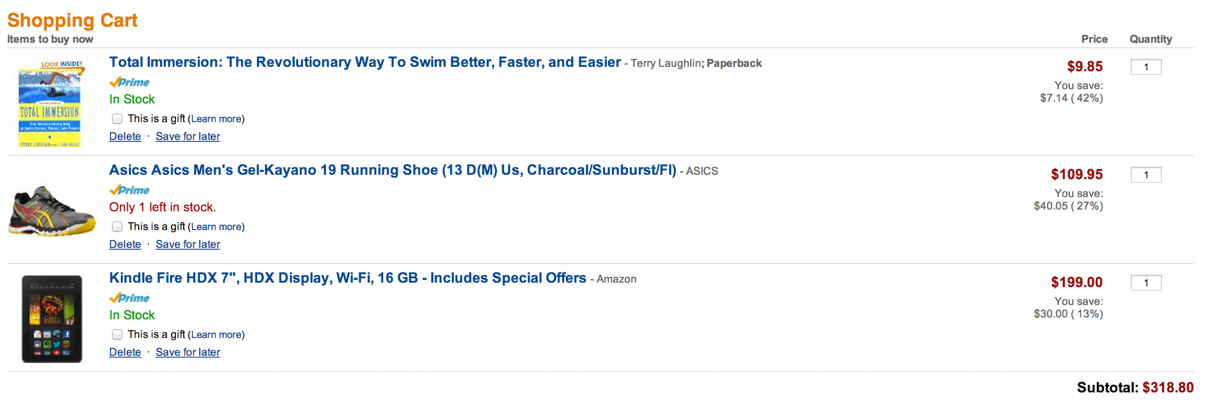
Which to Use?
Consider this shopping cart

Slide 193
java.util.Serializable
public class ShoppingCartItem implements Serializable {
public long cost;
public int quantity;
public String itemName;
public boolean inStock;
public String url;
}
Pros
Java standard
Works out of the box – no custom code
Cons
Least efficient in terms of CPU load
Biggest resulting payload
Uses reflection during deserialization
Does not support attribute changes !

Slide 194
java.util.Externalizable
public void writeExternal(ObjectOutput out) throws ... {
out.writeLong(cost);
out.writeInt(quantity);
out.writeUTF(itemName);
out.writeBoolean(inStock);
out.writeUTF(url);
}
public void readExternal(ObjectInput in) throws ... {
cost = in.readLong();
quantity = in.readInt();
itemName = in.readUTF();
inStock = in.readBoolean();
url = in.readUTF();
}
Pros
Java Standard
More efficient than Serializable in terms of CPU and memory
Cons
Requires the developer to implement the serialization code
Uses reflection during deserialization
Does not support attribute changes !

Slide 195
com.hazelcast.nio.serialization.DataSerializable
public void writeData(ObjectDataOutput out) throws ... {
out.writeLong(cost);
out.writeInt(quantity);
out.writeUTF(itemName);
out.writeBoolean(inStock);
out.writeUTF(url);
}
public void readData(ObjectDataInput in) throws ... {
cost = in.readLong();
quantity = in.readInt();
itemName = in.readUTF();
inStock = in.readBoolean();
url = in.readUTF();
}
Pros
More efficient than Serializable in terms of CPU and memory
Cons
Requires the developer to implement the serialization code
Uses reflection during deserialization
Does not support attribute changes !

Slide 196
com.hazelcast.nio.serialization.IdentifiedDataSerializable
public void writeData(ObjectDataOutput out) throws ... {
// like DataSerializable
}
public void readData(ObjectDataInput in) throws ... {
// like DataSerializable
}
public int getFactoryId() { return 1; }
public int getId() { return 1; }
public class MyFactory implements DataSerializableFactory { public IdentifiedDataSerializable create(int typeId) { switch (typeId) { case 1: return new ShoppingCartItem(); } throw new RuntimeException("Unknown type"); } }

Slide 197
com.hazelcast.nio.serialization.IdentifiedDataSerializable
Pros
More efficient than Serializable in terms of CPU and memory
Doesn’t need reflection
Cross-Language support
Cons
Requires the developer to implement the serialization code
Requires the developer to implement a factory
Does not support attribute changes !

Slide 198
com.hazelcast.nio.serialization.Portable
public void writePortable(PortableWriter out) throws ... {
out.writeLong("cost", cost);
out.writeInt("quantity", quantity);
out.writeUTF("name", itemName);
out.writeBoolean("stock", inStock);
out.writeUTF("url", url);
}
public void readPortable(PortableReader in) throws ... {
url = in.readUTF("url");
quantity = in.readInt("quantity");
cost = in.readLong("cost");
inStock = in.readBoolean("stock");
itemName = in.readUTF("name");
}
public void writePortable(PortableWriter out) throws ... {
// …
}
public void readPortable(PortableReader in) throws ... {
// …
}
public int getFactoryId() {
return 2;
}
public int getClassId() {
return 1;
}
public class MyFactory implements PortableFactory { public Portable create(int typeId) { switch (typeId) { case 1: return new ShoppingCartItem(); } throw new RuntimeException("Unknown type"); } }

Slide 199
com.hazelcast.nio.serialization.Portable
Pros
More efficient than Serializable in terms of CPU and memory
Doesn’t need reflection
Cross-Language support
Partial deserialization for queries
Supports attribute changes
Cons
Requires the developer to implement the serialization code
Requires the developer to implement a factory
Additional metadata to be sent

Slide 200
com.hazelcast.nio.serialization.ByteArray/StreamSerializer
public interface ByteArraySerializer<T> extends Serializer { byte[] write(T object) throws IOException; T read(byte[] buffer) throws IOException; }
public interface StreamSerializer<T> extends Serializer { void write(ObjectDataOutput out, T object) throws IOException; T read(ObjectDataInput in) throws IOException; }
Great for separation of concerns, does not implementation of an interface
Convenient and flexible
Often used for external serialization frameworks (like protobuffers, Apache Avro, Apache thrift, kryo, etc)
For kryo see: https://github.com/jerrinot/subzero

Slide 201
Simple Performance Test
 | Read Ops/ms | Write Ops/ms | Payload
Serializable | 56 | 46 | 514
Externalizable | 67 | 70 | 228
DataSerializable | 80 | 78 | 261
IdentifiedDataSerializable (supported by all Native Clients) | 80 | 78 | 192
Portable (supported by all Native Clients) | 73 | 68 | 417
Kryo (implemented with StreamSerializer) | 70 | 57 | 198

Slide 202
Runnables and Callables
Notes:
T = 55

Slide 203


What’s Wrong With This Application?
Hazelcast Instance
Nothing
It is easy to understand and for junior developers to maintain
Data moves across the network
Not good for big data
Another client could update the cluster while this client is processing
Not good for concurrent access
IMap “Hand”
Retrieve
Mutate
Save
Notes:
Application retrieves “hand” from cluster, modifies it, then writes it back to cluster. (all one animation)
Choice A
Choice B
Choice C

Slide 204
A Better Approach – Push the Code
Small network packet
Faster!
Working on the master copy
No concurrent modification worries
Needs processing code on IMDG server classpath
Extra deployment complication
Hazelcast Instance
IMap “Hand”
pair.getRight().setSuit(”Clubs");
pair.getRight().setRank("8");
Notes:
Push the code to the cluster to process

Slide 205
Push Code Options
java.lang.Runnable
com.hazelcast.map.EntryProcessor
java.util.concurrent.Callable
Process one entry at a time
Process code should be fast
Is specialized and optimized
More on this later
Can read/mutate multiple entries
Suitable for longer running processing

Slide 206
Runnable and Callable
Java standard tasks
Standard Java: run in another thread on same JVM
Hazelcast IMDG: thread can be in different JVM (cluster member)
An IMDG client or IMDG server invokes the runnable/callable
It runs on one of the servers in the IMDG
It runs on all of the servers in the IMDG in parallel
It runs on a subset of the servers in the IMDG in parallel

Slide 207
The Callable
You need a way to transmit the callable (the constructor arguments) to where it will run
public class MySleepyCallable implements Callable<String>, Serializable {
private long duration;
public MySleepyCallable(long arg0) {
this.duration = Math.abs(arg0);
}
public String call() throws Exception {
log.info("Start run of {} for duration {}ms", this, this.duration);
while (this.duration > STEP) {
this.duration -= STEP;
Thread.sleep(STEP);
}
Thread.sleep(this.duration);
log.info("End run of {}", this);
return "Ended at " + new Date();
}

Slide 208
The Caller’s Side
DurableExecutorService durableExecutorService = MyClient.hazelcastInstance.getDurableExecutorService("lab2");
MySleepyCallable myCallable = new MySleepyCallable(duration);
//submit to grid
DurableExecutorServiceFuture<String> future = durableExecutorService.submit(myCallable);
long taskId = future.getTaskId();
Future<String> future = durableExecutorService.retrieveResult(taskId);
//callable result
String result = future.get(1000, TimeUnit.MILLISECONDS);

Slide 209
The Callee’s Side
Configure a named execution pool on each server
<executor-service name="default">
<pool-size>16</pool-size>
<queue-capacity>0</queue-capacity>
</executor-service>

Slide 210
Lab 11: IExecutor Service
Run 3 slaves
Run 1 master
Master submits task to slaves and prints the total value of Sum
(write your own SumTask)
Estimated time: 20 minutes
Notes:
T = 85

Slide 211
Entry Processor

Slide 212
Entry Processor
Performs atomic computation on entries stored in distributed maps
Used for bulk processing of IMap data
Distributed in-memory processing on cluster
Eliminates client-server network hops
Notes:
The Hazelcast entry processor executes your code on a map entry in an atomic way.
Use the entry processor for bulk processing of data in your IMap. Using the entry processor will provide you with a huge improvement in your data handling performance in two ways:
Instead of processing your data locally at the application host, the cluster performs the processing. The more cluster members you have, the more parallel the processing becomes.
You also eliminate the overhead of sending gets and puts back and forth to your data store.
Let’s look at this more closely. In the old way,
Your application would request an entry from your data store,
Receive the returned data,
Process it,
Then return the result to update the data store
Then retrieve the next entry and repeat the process. And again, and again. Each entry process requires two network trips, plus you’re processing each entry serially on your application host.
With the entry processor on a Hazelcast cluster,
You submit the desired process to the cluster.
Each cluster member performs the requested process on all the map entries on their local partitions. They update the map entries as well.
The net result of the process is returned to the application.

Slide 213



Entry Processor
The Old Way
The Hazelcast Way
Get entry
Process
data
Put
data
Result
Repeat… and repeat…
Notes:
Let’s look at this more closely. In the old way,
Your application would request an entry from your data store,
Receive the returned data,
Process it,
Then return the result to update the data store
Then retrieve the next entry and repeat the process. And again, and again. Each entry process requires two network trips, plus you’re processing each entry serially on your application host.
With the entry processor on a Hazelcast cluster,
You submit the desired process to the cluster. Specifically, the client sends the entry processor to the directly connected cluster member.
That cluster member relays the entry processor to all other cluster members. Each cluster member then performs the requested process on all the map entries on their local partitions. They update the map entries, and return their local results to the cluster member connected to the client.
That cluster member collects all results, then returns the complete set to the client application.

Slide 214
Entry Processor Characteristics
No issues with locks or concurrency
Supports predicates to limit processing to a subset of the map data
Supports indexing to increase processing performance
Operate best when in-memory format is OBJECT
Read-only, mutating (read-write), and offloadable processors
Notes:
When using an entry processor, you do not have to worry about locks on map entries, or any concurrency issues. This is due to Hazelcast IMDG’s isolated threading model, which you can read about in detail in the IMDG Reference Guide.
You can use predicates in conjunction with the entry processor to limit the operation to a subset of the data in the map. We cover predicates in detail in the lesson on Queries.
If you’ve configured indexing, also discussed in the Queries lesson, the entry processor will automatically use them to further speed the processing of the data.
An entry processor works best on data that is stored in OBJECT format, as the data can be acted on directly without any delays related to serialization.
Hazelcast supports read-only, read-write, and offloadable processors. We’ll look at each of these in detail later in this lesson.

Slide 215
Entry Processor Advantages
No concurrency worries
The entry is yours til you’re done, but be quick!
Great for delta processing
Changing a small proportion of a big object
Pass the changing fields as arguments e.g. new delivery date for a big order
The changing fields can be implied rather than sent e.g. OrderCancelledEntryProcessor changes order status
Great if the processing is fast, just like a new value replacement
For processing a single entry, not for looking at other entries

Slide 216
Entry Processor Disadvantages
Must be on the server’s classpath
Not good if processing is slow
Reads and writes to the same key queue up
Offload processing can address this issue

Slide 217
Entry Processor Interface
interface EntryProcessor<K, V> extends Serializable {
Object process(Map.Entry<K, V> entry);
EntryBackupProcessor<K, V> getBackupProcessor();
}
The process method is a core of an entry processor
Accepts map entry, performs process, returns result
If there is no result, may return null
Entry backup processor executes on backup partitions to update backups if primary was updated
Must be explicitly defined if using entry processor interface
Notes:
The entry processor interface makes use of the process method.
It accepts the map entry, performs the specified process, then returns the result.
It’s a good idea to configure your process to return null if there are no results. This can reduce your memory footprint.
If your process is going to modify map entries, you should include the entry backup processor in order to update the entries in the backup partitions along with the primary partition data.
You do need to explicitly define this if you’re using the entry processor interface.

Slide 218
Abstract Entry Processor Class
public abstract class AbstractEntryProcessor<K, V> extends Object implements EntryProcessor<K, V>
Convenient base for implementing entry processors
Backup processor already implemented
If no backup processing is required (e.g. read-only), return null
Notes:
You can use the abstract entry processor class to make implementing your entry processors a little easier
For one thing, the backup processor is already implemented for you, so you don’t have to explicitly define the backup processor.
If your processor doesn’t change the data, the backup processor will return a null.

Slide 219
Entry Processor Example
private static class IncrementingEntryProcessor extends AbstractEntryProcessor<Integer, Integer> {
public Object process(Map.Entry<Integer, Integer> entry) {
Integer value = entry.getValue()
//Process and modify the value. We are just incrementing it by 1.
value=(value + 1);
//Return result of processing to map.
entry.setValue(value);
// here we're not returning any results from this class.
return null;
}
}
Notes:
Let’s play parser and go through this example code.
We’re going to use the abstract entry processor so we don’t have to worry about explicitly writing instructions for our backup copies of data.
Next, we create the entry processor itself.
We retrieve the entry value from the map and assign it to the variable called value.
Now we do our processing using the retrieved value. In this case, we’re just incrementing the value by 1.
Then we write the modified value back to the map.
Finally, we wrap up our class with a return statement. In this case, we’re not returning anything from this entry processor - we just did our calculation and map update and aren’t passing the results to another operation in our application.

Slide 220
Executing Entry Processors
mapname.executeOnEntries | Process all entries in a map
mapname.executeOnEntries Predicate | Process all entries that match the specified predicate
mapname.executeOnKey | Process an entry mapped by a key
mapname.executeOnKeys Collection | Process an entry mapped by a collection of keys
mapname.submitToKey | Asynchronously process an entry mapped by a key
IMap<Integer, Integer> sampleMap = hazelcastInstance.getMap("myMap");
sampleMap.executeOnEntries( new IncrementingEntryProcessor() );
Notes:
Once you’ve created your entry processor, you have to execute it against a given map. You have the five execution options shown.
Note that if you plan to run the entry processor against the entire map, you may run into performance issues, depending on the size of the map and the complexity of your process. We’ll discuss performance later in this lesson.
The entry processor only respects locks if the execution is on a single key - the two highlighted options shown. If the target key is locked, the execution will wait until the lock has been removed. You do not need to worry about locks with the other operations due to the Hazelcast isolated threading model. Because a single thread is handling all operations for the partition, there cannot be any interleaving of the entry processor with other mutations.
This code applies the entry processor we created on the last screen to the map called sample map. Let’s look at a demo that puts all this together.

Slide 221
Mutating Entry Processor
Modify map entries
Optionally return results from the process method
Collecting results takes cluster memory
Recommended to use Abstract EntryProcessor
executeOnKey and submitToKey will not run on locked keys
Notes:
What we just looked at is an example of a mutating entry processor.
The entry processor retrieved the map entry, performed a mutation - in that demo, added 1 to the value - then returned the mutated value to the map.
We could optionally have returned the collected results at the end of the entry processor to be passed to another operation in our code. In the case of the demo, we simply discarded the results.
Keep in mind that collecting the results takes up additional memory in the cluster, as each cluster member processes the data and sends the results to the collecting member. If you do not need the collected results - in other words, if another operation will be pulling the updated data from the map piece by piece - code your entry processor to return null.
In order to keep your primary and backup copies of the map consistent, we recommend using the abstract entry processor class to build your entry processor. The built-in backup handling means you don’t have to explicitly code for the backups.
And remember, the execute on key and submit to key will not run on a locked key; the entry processor will wait until the key is released.

Slide 222
Read-Only Entry Processor
Does not modify map entries
Marked with ReadOnly interface
Skips entry locking logic
UnsupportedOperationException is thrown if a read-only EP attempts to modify an entry
Optionally return results from the process method
Notes:
If you just need to retrieve entries, you can create a read only processor.
A read only entry processor doesn’t include a map put statement, so the map entries are not updated.
The processor is specifically marked with the read only interface,
Which allows the entry processor to bypass any locks on keys. Because we are not modifying the data, we do not need to worry about locked entries.
However, if you do create a read only entry processor that tries to write to a map, you will get an unsupported operation error.
As with the mutating processor, you can have the entry processor return the results of your operation when it finishes running, or return a null, depending on your objectives.

Slide 223
Entry Processor Performance
Design of entry processor assumes fast execution of the process method
What can slow things down?
Extremely large maps - use predicates, indexing, or process by key
BINARY entry format - incurs serialization/deserialization cost
Heavy code
Check during development with slow code detector system properties
hazelcast.slow.operation.detector.enabled - set to true (default)
hazelcast.slow.operation.detector.threshold.millis - set to 1 ms (default is 10000)
Notes:
With regards to performance,
Using an entry processor assumes that the operations within the processor are fast. Remember, this processor is used by a single partition thread. If other operations need to access the partitions, they have to wait until your entry processor has completed.
So what can slow things down?
Extremely large maps, especially if you do an execute on entries to process the entire map. Use predicates to limit the entries being processed, indexing to speed the locating of those entries, or process by key to be selective about what entries you’re processing.
If your entries are stored in binary format - the default format for maps - each entry has to be deserialized before it can be processed, then serialized again before being returned to the map.
Finally, your process code itself may be the problem, if it is performing extensive computation with each entry.
You can use the built-in slow code detector system properties during development to check for issues.
The slow operation detector is always enabled, but the threshold is by default set to ten thousand milliseconds. You can set this down to 1 millisecond to see if there are any potential issues with your entry processors.

Slide 224

Offloadable Entry Processor
Offloads execution processing to separate executor thread
.
.
.
ops
ops
get
Executor thread
Partition thread
ops
Partition thread
put
result
EP
put
ops
get
get
Notes:
If you do run into performance issues, you can use the offloadable entry processor to bypass any bottlenecks your code is creating in the partition thread.
By default, the partition thread handles the entire entry processor
… along with all other partition-related operations.
If your entry processor is taking too long to complete, other partition operations may be delayed.
The offloadable entry processor shifts the heavy lifting to a separate executor thread.
The partition thread still performs a get, does deserialization iif the data is in binary format, locks the key if the entry processor is a mutating EP, then passes the entry to the executor thread.
The executor thread does all the processing.
While the executor thread is processing, the partition thread can handle other enqueued operations.
When the executor is done, it passes the result back to the partition thread.
If it’s a mutating entry processor, the partition thread serializes the data if needed, performs the put, and unlocks the key.
It then gets the next entry and the process repeats itself until all the entries have been processed,

Slide 225
Implementing Read Only/Offloadable
Add to EP
private static class MyEntryProcessor extends AbstractEntryProcessor<Integer, Integer>
implements ReadOnly {
private static class MyEntryProcessor extends AbstractEntryProcessor<Integer, Integer>
implements Offloadable {
private static class MyEntryProcessor extends AbstractEntryProcessor<Integer, Integer>
implements Offloadable, ReadOnly {
Offloadable only applies to executeOnKey or submitToKey
Notes:
To make an entry processor read only or offloadable, just mark its implementation as read-only or offloadable using the corresponding marker interfaces. You can also combine offloadable and read only.
Note that the offloadable entry processor only applies when using execute on key or submit to key execution methods.

Slide 226
Lab 12: Entry Processor
Run 3 slaves
Run 1 naïve client
Observe values as read – are they expected?
Run Entry Processor client
Observe values as updated and read – are they expected?
Estimated time: 15 minutes
Notes:
T = 120

Slide 227
Stretch/Bio Break
15 Minute Break
Notes:
Time upon return: 130 minutes.

Slide 228
Entry Listener
15 minute break

Slide 229
Thinking Reactive
E-Commerce application with multiple IMDG servers
We want to count the value of today’s sales
Good
We could do a “cursor”
query for matching records, bring them to the caller, total the order amounts
simple to understand and easy to maintain
Better
We could submit a Callable to the grid to total each server’s orders
Parallelizable and scalable, each server tallies only the data it holds
only the subtotal from each Callable instance passes across the network
slightly harder to understand, but faster
Best
Update the totals as orders as place
What facilitates this reactive style ? Event listeners

Slide 230
Hazelcast Eventing Framework
Events generate notifications
Data changing in IMap
Data added to IQueue
Data migration
Cluster member add/drop
Etc.
Events only published if something is listening

Slide 231
Map Listener
Listen for map-wide or entry-based events
MapClearedListener MapEvictedListener EntryAddedListener EntryEvictedListener EntryRemovedListener EntryMergedListener EntryUpdatedListener EntryLoadedListener
Can include code to execute after event occurs
Generates event
Extension of event listener interface
Notes:
The map listener allows you to monitor your map and register that activity has taken place. You can listen for both map-wide events and events that modify individual entries.
The list of available listeners is on your screen. In short, the map-level listeners are triggered when the entire map has been either cleared or evicted. The entry listeners are triggered when an entry has been added, evicted, removed, merged, updated, or loaded from a data store.
A listener can include code to be executed after the listened-for event occurs.
A listener also returns an event that includes information about the action that triggered the listener.
Map listener is an extension of the Hazelcast event listener interface, which provides listening functionality for several other types of events in addition to map listener.

Slide 232
Map Listener Example
public class ListeningMember {
public static void main(String[] args) {
HazelcastInstance hz = Hazelcast.newHazelcastInstance();
IMap<String, String> listenToMe = hz.getMap("someMap");
listenToMe.addEntryListener(new MyEntryListener(), true);
System.out.println("EntryListener registered");
}
private static class MyEntryListener implements EntryAddedListener<String, String>,
EntryRemovedListener<String, String>, EntryUpdatedListener<String, String> {
@Override
public void entryAdded(EntryEvent<String, String> event) {
System.out.println("entryAdded: " + event);
}
// create corresponding objects for removed and updated listeners
}
}
Notes:
Let’s play parser once again and look at an implementation of map listener.
We’re going to create a complete instance of Hazelcast that performs the listening function. When an event is triggered, we’ll print to the system output for this instance.
We begin with the usual main line
Start an instance of Hazelcast
Create our IMap
Enable the entry listener class we’ll create later in the code.
When this instance starts, we’ll print out a line confirming that the listener is enabled and ready to report map changes.
(bracket)
Which changes? MyEntryListener is going to listen for entries being added to the map, entries removed from the map, and entries updated in the map.
(override)
For each specific event,
We’ll print out the action that was taken - in this case, an entry has been added - then print the details of the actual event. We could also add code here that executes immediately after this event occurs.
(bracket)
We’d repeat similar code for removed entries and updated entries.
(bracket)
(bracket) Now we’ll look at a live demo that modifies the map we’re listening to

Slide 233
Listener with Predicate
Listens to modifications performed on entries matching predicate
listenToMe.addEntryListener(new MyEntryListener(), new SqlPredicate("name = Smith") true);
Notes:
You can add predicates to your map listeners.
Adding a predicate limits the listener to register activity only if the entry matches the configured predicate.
So in our example, if we only wanted to listen for activity on entries where the name is Smith, we add the predicate when we apply the entry listener to the map.

Slide 234
Local Listener
Only listens for events on local partitions
Can add predicate to entry listener
String addLocalEntryListener(MapListener listener);
String addLocalEntryListener(EntryListener listener);
Partitions can migrate for load balancing
Notes:
Another option is to deploy a local listener.
This listener only reports events that occur on partitions maintained by the cluster member running the listener. We’ll explain listener deployment on the next slide.
As with the entry listener, you can add predicates to limit the listener to reporting on entries that match the predicate.
You can listen locally for both map-level and entry-level changes.
Just remember that partitions themselves are not statically assigned to any given cluster member. They can be moved for load balancing purposes, so a local listener may stop reporting for certain entries because the partition holding those entries may no longer be on the local member.

Slide 235

Deploying Listeners
Single member instance
Run as code
Client application
In map configuration
On all members
Use local listener to prevent duplicate actions
Client application
Notes:
Once you’ve created the listener class, you have a couple of options for how you deploy your listener.
You can run the listener as an application.
If you run the application directly on a single cluster member, only that cluster member will have an instance of listener running. The listener will fire on any map activity, whether it is on the same member or a different member in the cluster.
You can also run the listener as a separate client application.
You also have the option of including the listener in your map configuration.
If you include the listener in the map configuration on the cluster, all instances of the cluster will run the listener. This is where local listener comes into play; because every cluster member is listening, each member will fire its own event in response to a map change. This creates duplicate actions. You can avoid this by using local listener so that each listener only responds to events that occur on the local cluster member.
In a client-server setting, you can include the event listener in your map configuration and the listener will run in conjunction with the application using the referenced map.

Slide 236
Adding Listener to Configuration
<hazelcast> ... <map name="somemap"> ... <entry-listeners> <entry-listener include-value="false" local="false"> com.yourpackage.MyEntryListener </entry-listener> </entry-listeners> </map> ... </hazelcast>
Notes:
Entry listeners is part of the map configuration. Under entry listeners, specify the package that contains your listener class.
The include-value setting determines whether the returned event includes the value from a modified entry. The default is true, but you can disable it as shown.
The local setting determines whether the listener will listen to the map on the local member. It’s default value is false.

Slide 237
Listener Result
When data changes, you get sent a com.hazelcast.core.EntryEvent that includes
the entry’s key
the old value (null for create)
the new value (null for remove)
the event type
the map it occurred on
the Hazelcast member it occurred on

Slide 238
The Architect’s View
Significant design pattern change – you can now create reactive processing
Use case: online shop using IMap to store orders
Actions on order processing are shipping, confirmation email and restocking the shelf
You could scan the IMap for orders needing handling, a daily batch
You could react to each order being placed by doing the consequential actions
customer gets the confirmation email almost immediately
shipping occurs sooner, keep up with your competitors
stock is re-ordered as soon as the low stock threshold is reached

Slide 239
Three Additional Points
The invocation happens in Hazelcast’s thread so needs to execute quickly, or spawn another thread
The event has already happened (perhaps on another JVM) so you can only react
Interceptor (on next slide) can be used to stop things from occurring
Events are delivered via a queue
Queue has finite capacity of 1,000,000 events

Slide 240
Interceptors
Synchronous operation triggered by map event
Listeners are asynchronous - can trigger a subsequent action
Interceptors literally intercept the event
Interceptors can
Alter the behavior of an operation
Change the operation value
Cancel an operation
Notes:
An interceptor is an operation that, like a listener, is triggered by a map event. However, unlike a listener, interceptors are synchronous operations.
Listeners are asynchronous. You can configure a listener to trigger an action, but that action will take place after the listened-for activity has occurred.
Interceptors, on the other hand, literally intercept the looked-for event.
Once intercepted, you can
Alter the behavior of an operation
Change the value of the operation,
Or cancel the operation altogether and throw an exception.

Slide 241
Interceptor Options
interceptGet | Replace returned map value with new value
afterGet | Action to take after get is done
interceptPut | Replace value in put with new value
afterPut | Action to take after put is done
interceptRemove | Collects removed map value
afterRemove | Action to take after remove is done
Notes:
You can specify which action to intercept - a get, a put, or a remove. In each case, you can replace the value from the action with a new value. You can also include code for additional actions to take instead of performing the get, put, or remove.
You can also configure actions to take after the get, put, or remove itself is done, but before the operation is considered completed.

Slide 242
Interceptor Example
private static class MyMapInterceptor implements MapInterceptor {
@Override
public Object interceptGet(Object value) {
return value + "-foo"
;
}
}
...
IMap<String, String> myMap = hz.getMap("myMap");
myMap.addInterceptor(new MyMapInterceptor());
Notes:
In this example, we’ve created an interceptor that acts when you get a value from the map. The interceptor collects the value, adds the string “foo”, and returns the modified value.
We add the interceptor to myMap with add interceptor. Now we’ll look at a demo of this interceptor, then we’ll do some modifications so you can see what happens with the different functions.

Slide 243
Data Change Review
Before: To stop or adjust an entry change immediately prior
During: To change the entry in-situ
After: To react to entry change almost immediately after
com.hazelcast.map.MapInterceptor
com.hazelcast.map.EntryProcessor
com.hazelcast.map.listener.EntryAddedListener
com.hazelcast.map.listener.EntryEvictedListener
com.hazelcast.map.listener.EntryExpiredListener
com.hazelcast.map.listener.EntryMergedListener
com.hazelcast.map.listener.EntryRemovedListener
com.hazelcast.map.listener.EntryUpdatedListener

Slide 244
Messaging
Notes:
T = 155

Slide 245
Hazelcast Messaging
Hazelcast implementations of basic messaging structures
Queue
Topic
Easy to use
Hopefully familiar concepts
Distributed implementations (of course)
Configurable

Slide 246
IQueue
Hazelcast distributed implementation of java.util.concurrent.BlockingQueue
Runs on any cluster member
FIFO operation
Can be bounded to enforce a max size
Works with underlying persistent storage for durability
Works with listener processes for event based processing
All the usual queuing functionality
Client can add to end, pull from front

Slide 247
IQueue Operations
IMDG Cluster
Queue cannot be partitioned
Entire queue must fit in instance
Hazelcast maintains primary and backup (if configured)
Proxy process relays offers/takes if queue is not local
Hazelcast Instance
Hazelcast Instance
Hazelcast Instance
Queue ”fred”
Queue ”fred”
Queue ”joe”
Queue ”joe”
fred.take()

Slide 248
IQueue is Easy to Use
IQueue<Date> theQueue = this.hazelcastInstance.getQueue(”when");
Date now = new Date();
theQueue.offer(now);
TimeUnit.SECONDS.sleep(5L);
Date then = theQueue.take();
System.out.println("Same ? " + then.equals(now));

Slide 249
Bounded IQueue
Entire queue must fit on one cluster member
Default: no limit on queue size
Configure max-size property to limit queue
Size = number of items in queue
When limit reached, put operations are blocked
IQueue.offer() returns false, item not added, when queue is full
IQueue.put() blocks when queue is full

Slide 250
Configuring IQueue
Queue size
Number of backups
Entry max time to live
Items can expire from the queue
<queue name=”when">
<max-size>30</max-size>
<backup-count>0</backup-count>
<async-backup-count>1</async-backup-count>
<empty-queue-ttl>86400</empty-queue-ttl>
</queue>

Slide 251
IQueue with Listener
Similar to MapListener
Code listener methods using EventListener interface
Apply to queue via configuration
public void itemAdded(ItemEvent itemEvent) {
}
public void itemRemoved(ItemEvent itemEvent) {
}
<queue name=”when">
<item-listeners>
<item-listener include value="true">the.package.MyItemListener</item-listener>
</item-listeners>
</queue>

Slide 252
IQueue with Persistent Store
Similar to MapStore
Create class to access external store
Implement these methods to ship queue data in/out of store
Key (position in queue) is Long
public void delete(Long arg0)
public void deleteAll(Collection<Long> arg0)
public Object load(Long arg0) {
public Map<Long, Object> loadAll(Collection<Long> arg0)
public Set<Long> loadAllKeys()
public void store(Long arg0, Object arg1)
public void storeAll(Map<Long, Object> arg0)

Slide 253
IQueue with Persistent Store (part 2)
Apply store to queue via configuration
<queue name=”when">
<queue-store>
<class-name>the.package.MyQueueStore</class-name>
<properties>
<property name="binary">false</property>
<property name="memory-limit">3</property>
<property name="bulk-load">5</property>
</properties>
</queue-store>
</queue>

Slide 254
Topic/Reliable Topic
Pub/Sub messaging model
Publisher submits message
Cluster relays to subscribers
Cluster-wide – any member can publish
Reliable Topic backed with Ringbuffer
Provides backup
Each topic has own buffer
No competition for event handler
Hazelcast IMDG (Distributed Topic Bus)
Topic Bus
MSG
MSG
MSG
Client
(Publishers)
Client
(Subscribers)
Client
(Subscribers)

Slide 255
ITopic
ITopic<String> englishTopic = hazelcastInstance.getTopic("english");
ITopic<String> frenchTopic = hazelcastInstance.getReliableTopic("french");
englishTopic.publish("hello");
frenchTopic.publish("bonjour");
Simple to use
Payload does not have to be a string
Can be any serializable class
Two implementations – Topic and ReliableTopic

Slide 256
Subscribing to a Topic
Add a callback
Output:
englishTopic.addMessageListener(new MyMessageListener());
frenchTopic.addMessageListener(new MyMessageListener());
class MyMessageListener implements MessageListener<String> {
@Override
public void onMessage(Message<String> message) {
System.out.println(message.getSource() + "," +
message.getMessageObject());
}
}
english,hello
french,bonjour

Slide 257
Using ITopic
Any process can send
Any process can receive if it registers a listener
Servers
Clients
Some, none or all processes – even the sending process if wanted
The listener is invoked for messages published *after* the listener is registered

Slide 258
Reliable and “Unreliable”
ITopic<String> englishTopic = hazelcastInstance.getTopic("english");
ITopic<String> frenchTopic = hazelcastInstance.getReliableTopic("french");
The getTopic style has no backups
Faster to update
If the hosting member crashes, messages in flight may be lost
The getReliableTopic style has backups
Backed by a Ringbuffer

Slide 259
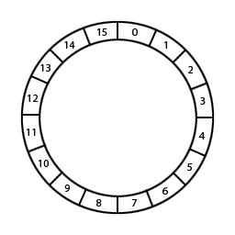
Ringbuffer
Distributed (not partitioned) data structure
Stores the items in a single, fixed-size buffer (array)
Items are identified by a sequence
Tail sequence - newest items
Head sequence - oldest items
StaleSequenceException
Has a read position and a write position

Slide 260
Ringbuffer Configuration
<ringbuffer name=”wagner">
<capacity>5</capacity>
<backup-count>1</backup-count>
<async-backup-count>0</async-backup-count>
<time-to-live-seconds>0</time-to-live-seconds>
<in-memory-format>BINARY</in-memory-format>
</ringbuffer>
Backup count is what makes ITopic reliable

Slide 261
Writing to the Ringbuffer
Ringbuffer<String> germanRingbuffer =hazelcastInstance.getRingbuffer("wagner");
germanRingbuffer.add("montag");
germanRingbuffer.add("diestag");
germanRingbuffer.add("mittwoch");
germanRingbuffer.add("donnerstag");
germanRingbuffer.add("freitag");
germanRingbuffer.add("samstag");
germanRingbuffer.add("sonntag");

Slide 262
Reading from the Ringbuffer
long head = germanRingbuffer.headSequence();
System.out.println(germanRingbuffer.readOne(head));
long tail = germanRingbuffer.tailSequence();
System.out.println(germanRingbuffer.readOne(tail));
Do not have to read from end
Read does not remove an item
Can re-read

Slide 263
Capacity…
Capacity set to 5
So, at write…
When we read head and tail
<capacity>5</capacity
Output:
mittwoch
sonntag
Write here
montag
samstag
sonntag
diestag
mittwoch
donnerstag
friestag
Notes:
Capacity set to 5 – config excerpt
At write… index fills and loops
T = 175

Slide 264
Hazelcast Threading
Notes:
T = 175

Slide 265
I/O Threading
3 types of NIO:
Accept Requests - 1 thread
Read data from other members/clients - # configured
Write data to other members/clients - # configured
hazelcast.io.thread.count
Default is 3
If set to 3 then 7 I/O threads in total - 1 Accept, 3 Read and 3 Write
Each I/O thread has its own Selector instance and waits on the Selector.select for next I/O operation

Slide 266
I/O Threading
Automatic rebalancing of IO thread
Periodic scan of thread utilization, if found over-used then connection is shifted to another thread
hazelcast.io.balancer.interval.seconds - scanning interval. Default is 20

Slide 267
Event Threading
Shared Event system for events driven components: Topic, Listeners, Near Cache
Every member has array of event threads EventThread[]
Every Thread in the array has its own work queue
ET[n] = Qn
On an event:
An event thread from the array is selected, based on message ordering and thread load
Event is placed on the work queue of this thread

Slide 268
Event Threading
hazelcast.event.thread.count: Number of event-threads in this array. Its default value is 5
hazelcast.event.queue.capacity: Capacity of the work queue. Its default value is 1000000
hazelcast.event.queue.timeout.millis: Timeout for placing an item on the work queue. Its default value is 250

Slide 269
Event Threading
Increase hazelcast.event.thread.count if you have many cores
Multiple components share event threads and queues: recommended to offload processing of events to a dedicated thread pool
Topics A and B publish messages
Some messages share the queue and hence the same event threads
If event thread takes lot of time in processing A’s messages, B will suffer because of thread starvation

Slide 270
Event Threading
Problems: Event system is a “best effort” system i.e. no guarantee that you will get an event
If the events are produced at a higher rate than they are consumed, the queue grows in size
When Queue’s maximum capacity is reached, the items are dropped
Topic A has lot of pending messages
Queue has no capacity and messages for B are dropped
B does not receive messages

Slide 271
Operations Threads
2 types of operations
Partition Aware operation e.g. IMap.get(key)
Non Partition Aware operation e.g. IExecutorService

Slide 272
Partition-Aware (Partition) Threads
Operation Thread <> Queues
Default thread count = 2 x number of cores, min 2
hazelcast.operation.thread.count
Operation thread consumes messages from its own work queue. To find the thread to process operation:
threadIndex = partitionId % partition thread-count
After threadIndex is determined, operation is put in the work queue of that operation thread

Slide 273
Partition-Aware Threads
A single operation thread executes operations for multiple partitions
271 partitions / 10 partition threads = 1 thread per 27 partitions
Each partition belongs to only 1 operation thread
All operations for a partition are always handled by the same operation thread
Concurrency control not needed

Slide 274
Non-Partition-Aware (Generic) Threads
Default thread count = (number of cores) / 2, min 2
hazelcast.operation.generic.thread.count
All generic operation threads share a single work queue: genericWorkQueue
Automatic work balancing: Operation in work queue can be handled by any generic operation thread
Shared queue can be a point of contention
Notes:
T = 190

Slide 275
Q and A
Next Up … Comprehensive Lab

Slide 276
Lunch Break
60 Minute Break

Slide 277
Comprehensive Streaming Lab

Slide 278
The Scenario
In this lab, we will be developing solutions for a truck rental company, UMove. All trucks in the UMove fleet are equipped with GPS and engine monitoring devices which periodically transmit location and other information over cell networks. We will be designing solutions that help UMove turn the continuous stream of data produced by their fleet into meaningful insights, and to act on those insights in near real time.

Slide 279
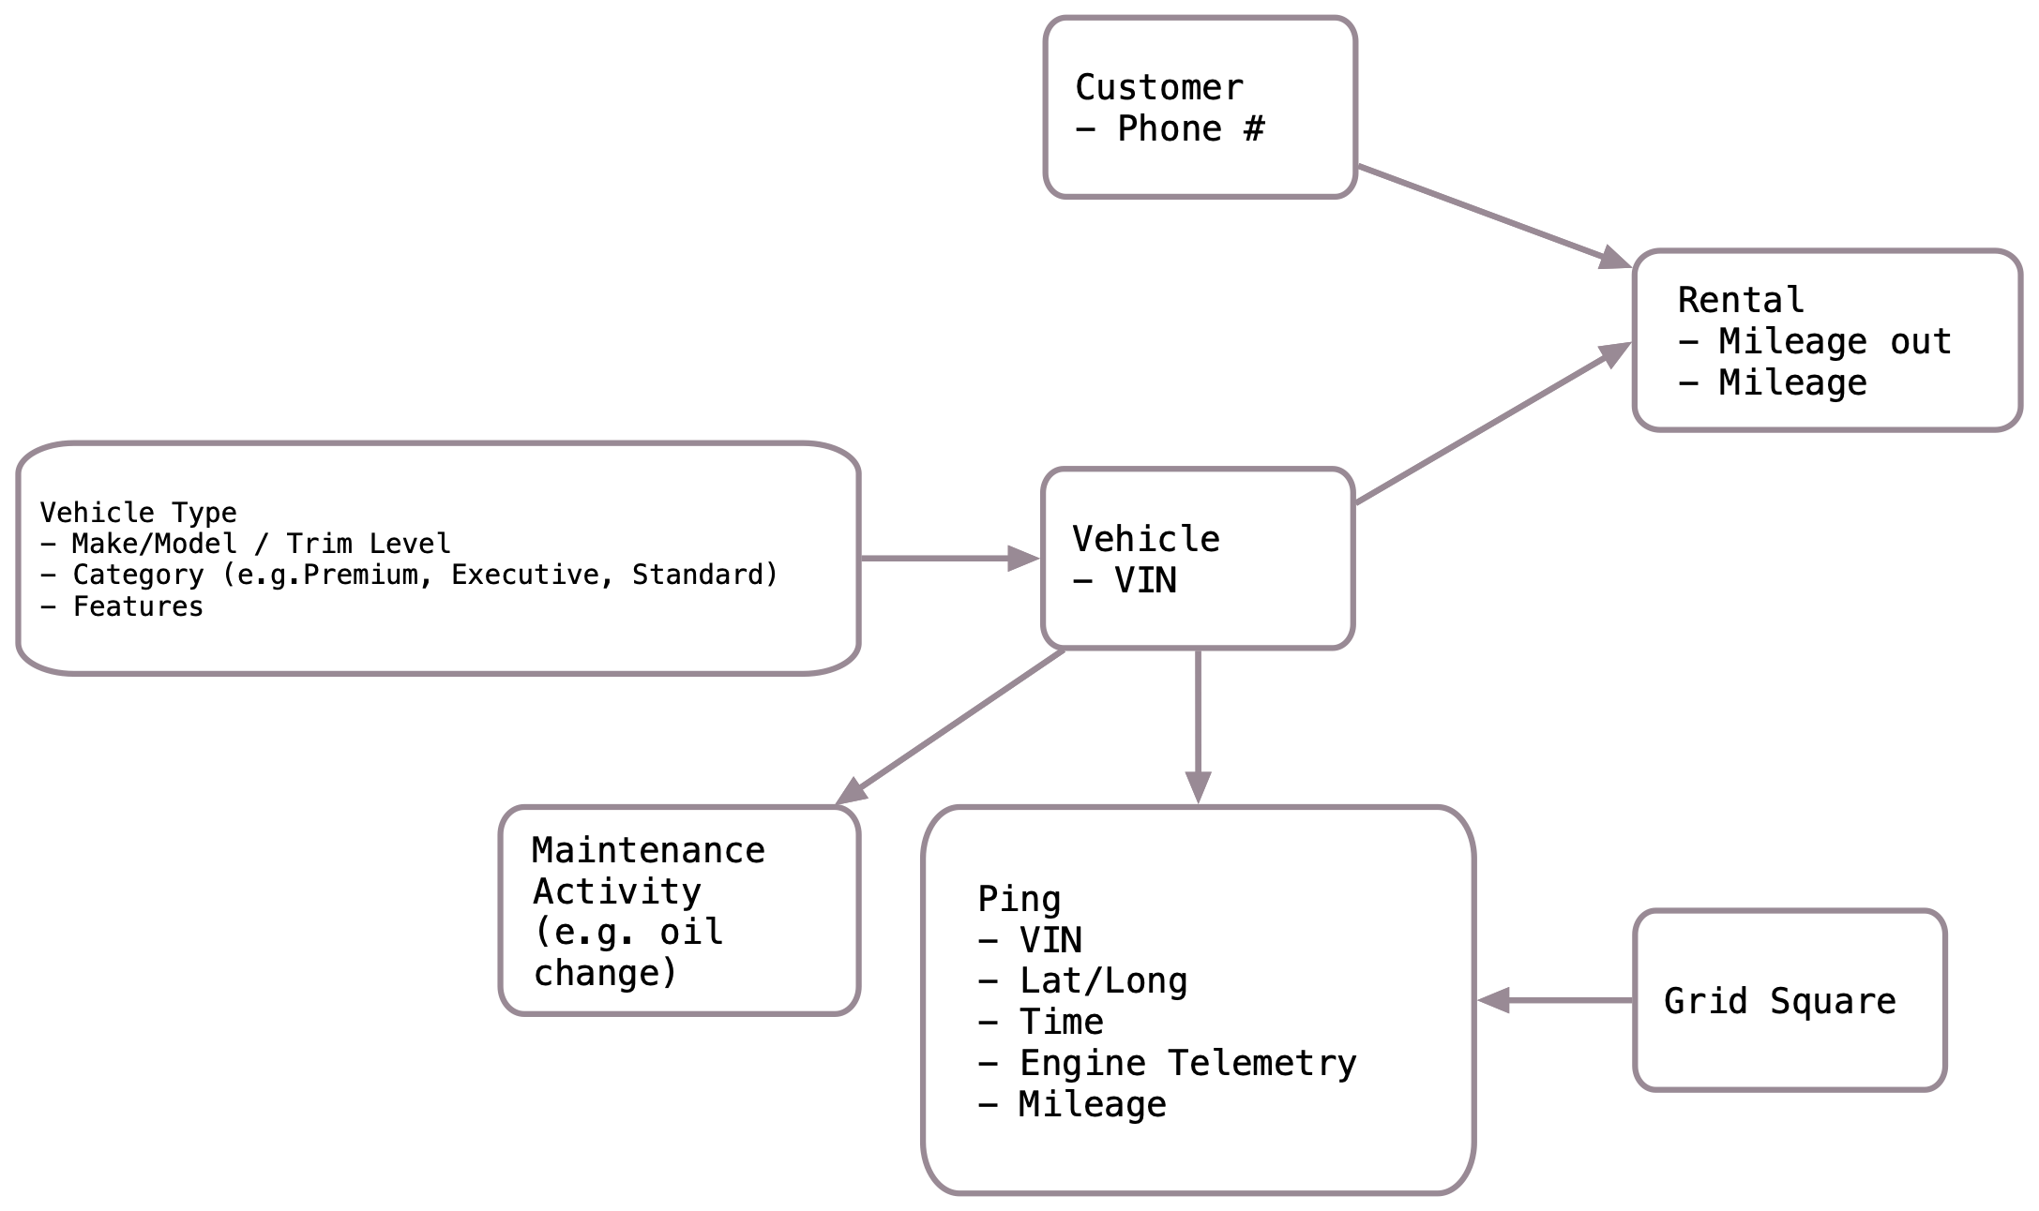
Data Model

Slide 280
Lab 1: Environment Orientation
Let’s Get Started …
Make sure that you have Docker Desktop installed.
Obtain the materials from: https://github.com/wrmay/in-depth-streams-with-hazelcast
Additional instructions for each lab are in the above materials. The first task is to gain access to the lab documentation. There are two ways …
Use your browser to view the ”doc” folder directly on GitHub (you will a GitHub login).
OR, in the local materials, cd to the “doc” directory and run the “./start.sh” or “start.bat”. You will then be able to access the document locally using your browser at: http://localhost:3000
Once you have access to the documentation, work your way through the environment orientation lab. The expected time required is 20 minutes.

Slide 281
What we Learned …
How to access the lab documentation
How to use docker-compose to start and stop the environment
How to log on to and inspect a running container.

Slide 282
Lab 2: Configuring and Starting Jet
Hazelcast IMDG and Jet are both easy to embed and both work well with Spring. In this lab, we will work through a variety of options for configuring and starting Jet.
Expected time: 60 minutes

Slide 283
What we Learned …
Starting Jet using the scripts.
Configuring the underlying IMDG instance
Jet serverless deployment using a simple java program.
Jet serverless deployment using Spring Boot

Slide 284
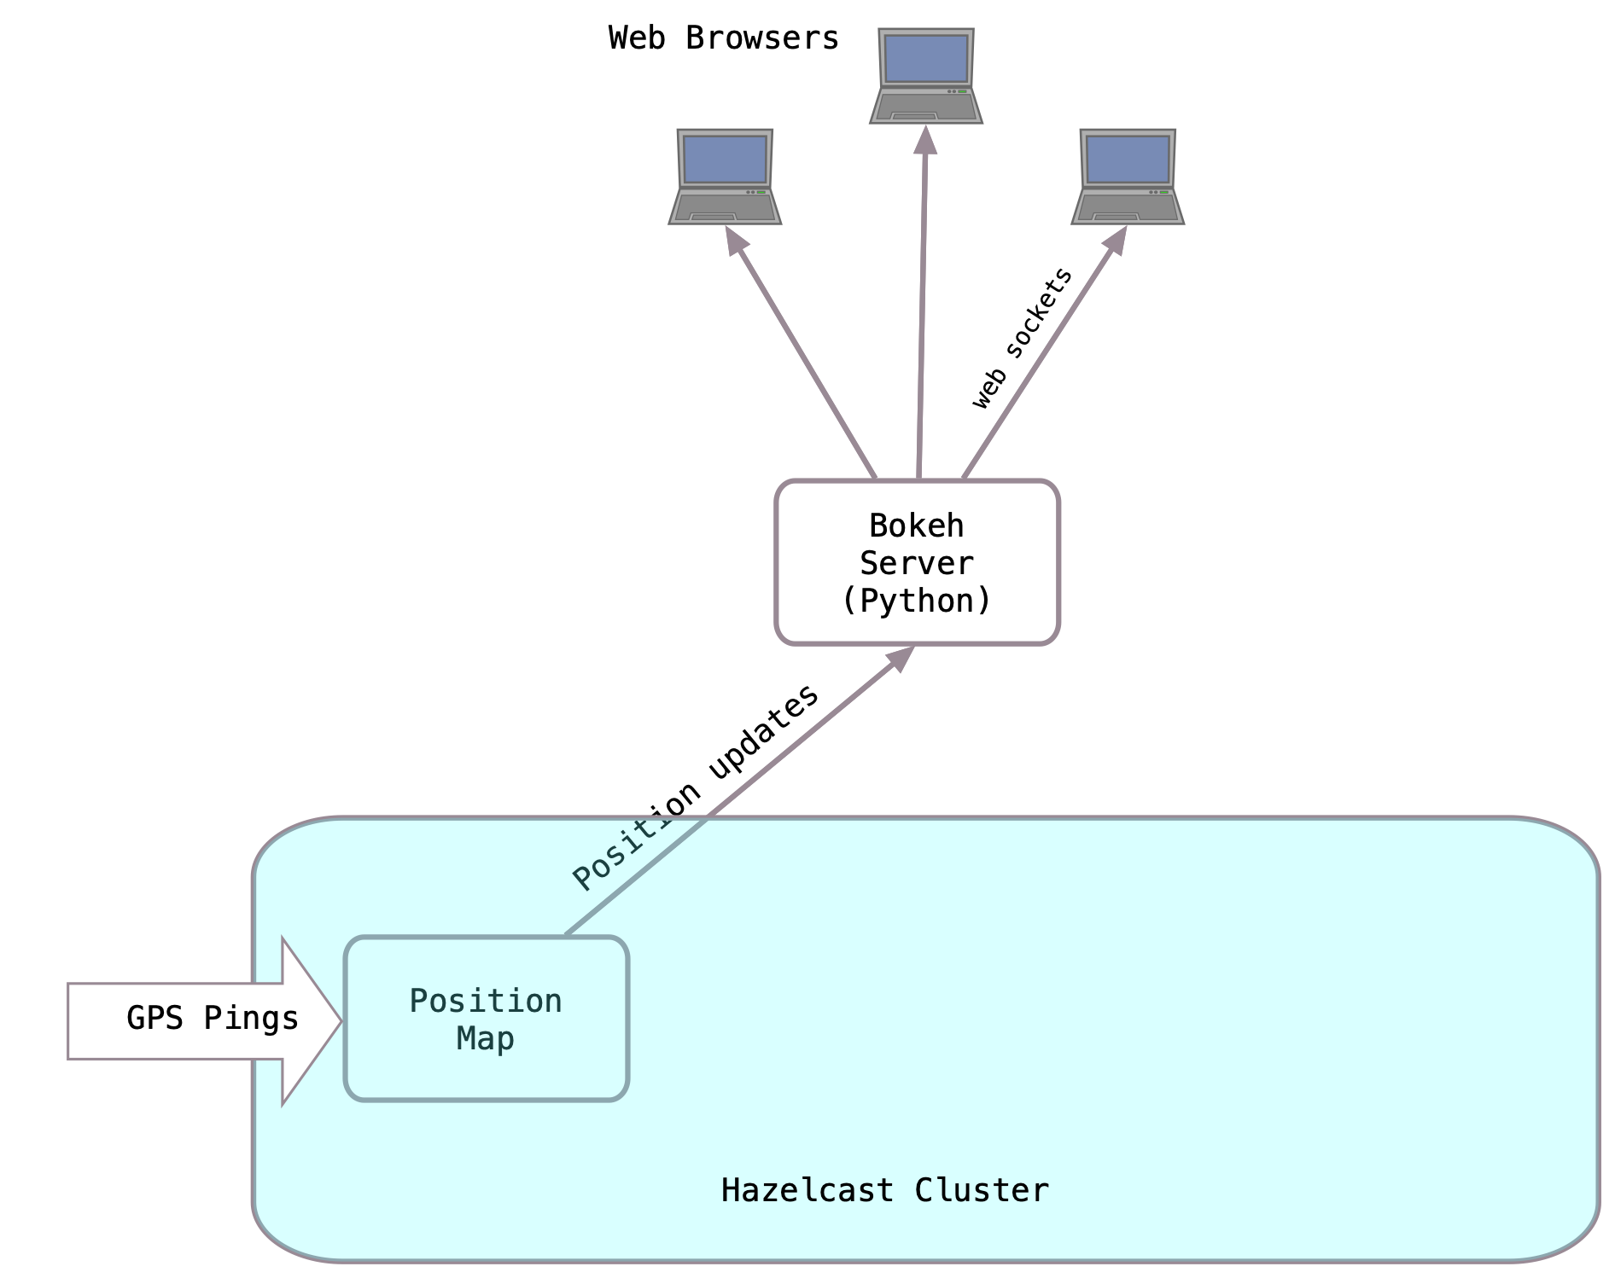
Lab 3: Ingest GPS Data
In this lab we are going to ingest the GPS data. The basic architecture is depicted below.
The arrow is the Jet job we will write (more details to come)

Slide 285
Hazelcast Sources and Sinks
Review the sources and sinks documentation with respect to
Batch / Stream
Replayability
Checkpoint Support
Distribution
Data Locality

Slide 286
Hazelcast IMap and Event Journals
IMaps are the glue between IMDG and Jet
Because there are many IMDG clients, IMaps are often the Source/Sink of choice for integrating with external systems.
Review event journal configuration documentation.
Event Journal Best Practices
Thinking through expiration and eviction.
How to size the event journal

Slide 287
Lab 3 Instructions
See “03. Ingest.md” for details

Slide 288
What we Learned …
Starting Jet using the scripts.
Configuring the underlying IMDG instance
Jet serverless deployment using a simple java program.
Jet serverless deployment using Spring Boot

Slide 289
Lab 4 - Updates
Its now time to make an update to our system. Lets see how this can be done with no downtime using snapshots. Talk about stable sources and idempotent sinks, how Jet does restart and recovery.
1 hr

Slide 290
Lab 5 - Enrich
We want the vehicle make/model information and category added to the vehicle map. This is static so it’s a perfect use case for hash join. We will integrate with a JDBC source to obtain it.
Update the current ingest job.
Do a second enrichment to determine the grid square. This is best done using “mapUsingContext”.
Now we have a map entry that looks like this: TBD
1 hr.

Slide 291
Lab 6 – Maintenance Alerts
To support emergency maintenance notifications …
Filewatcher – notice per make/model
Flat map to one per vehicle – group by VIN
Custom Sink to emit notification
1hr.

Slide 292
Lab 7 – Calculate Velocity and Miles Driven
Use the vehicle map as a source
Custom aggregator to compute velocity (possibly do this as coaggregate?), then map to categorize. Write output to another map using EP to deal with change detection.
Now we can see in real time who is speeding !
1 hr.

Slide 293
Lab 8 – Vehicles in an Area
Lets make the customer notification function reusable by breaking it off into its own stream – source is a map.
Similar to the service notifications, use a query to identify customers in an area right now and send them notifications.
Speed up the query with an index.
What about vehicles that enter later ? Repeat the notification (once every x minutes), use executor framework
1 hr.

Slide 294
Lab 9 – Mileage Limits
Notify in real time when a luxury vehicle has almost exceeded its limit.

Slide 295
Lab 10 – Daily Report of Vehicles Due for Maintenance
More traditional ETL using batch streams.

